Slide 1
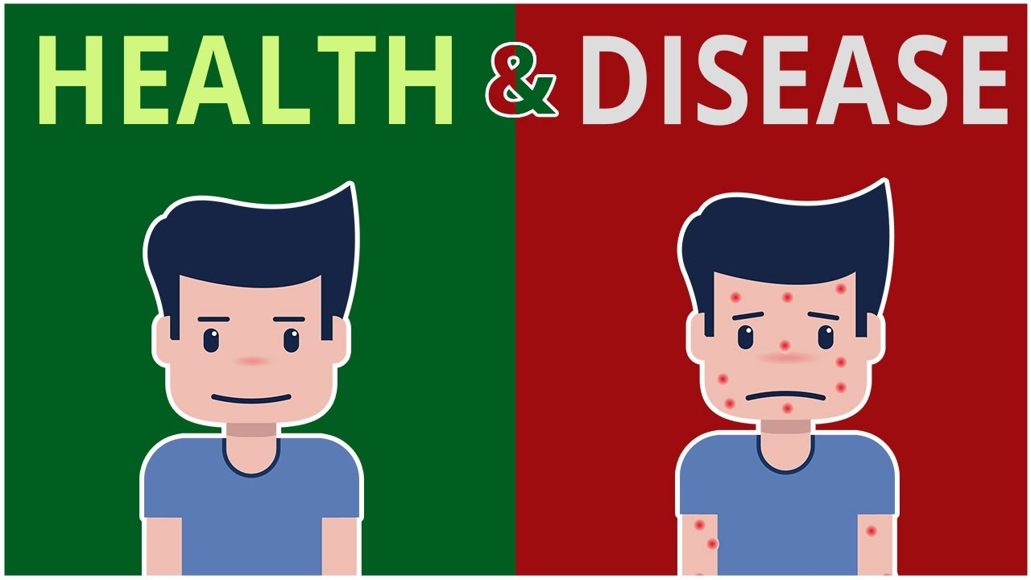
DISEASE

Slide 2
SOME IMPORTANT TERMS TO REMEMBER
Pathogen : A living organism which causes a disease.
Parasite : An organism which gets food and shelter from host.
Host : The living body on or inside which the disease-producing organism takes shelter.
Infestation : A large number of parasitic organisms present on the surface of body of the host or on the clothing.
Vector : It is an organism which harbours a pathogen and may pass it on to another person to cause a disease (Mosquitoes harbour malarial parasite and transmits it to humans).
Carrier : It is an organism which itself does not harbour the pathogen but physically transmits it to another person (Housefly is the carrier of cholera germs).

Slide 3
SOME IMPORTANT TERMS TO REMEMBER
Epidemic : Spreading of a disease among a large number of people in the same place for some time e.g. plague.
Endemic : A disease which is regularly found among a particular group of people e.g. goitre
Symptoms : Specific expressions which appear on the deseased and help in the identification of the disease.

Slide 4
SOME IMPORTANT TERMS TO REMEMBER
Pandemic : A disease which is found all over the world e.g. AIDS.
Interferon : Type of proteins produced by infected cells of the body when attacked by a virus, which act to prevent the further development of the virus.
Inoculation : Introduction of antigenic material inside the body to prevent suffering from a disease.
Vaccination : Injection of a weak strain of a specific bacterium (Vaccine) in order to secure immunity against the corresponding disease. It is also called immunisation.
Incubation period : The period between entry of pathogen inside a healthy body and appearance of the symptoms of the disease.

Slide 5
DISEASE
Any condition which interferes with the normal functioning of the body is called a disease.
In other words, disease may be defined as a disorder in the physical, physiological, psychological or social state of a person caused due to nutritional deficiency, physiological disorder, genetic disorder, pathogen or any other reason

Slide 6
HEALTH
Health is defined as a state of complete mental and social well being.
Factors responsible:
  Genetic disorder
  Infections
  Life style
Balanced diet ,Personal hygiene and regular exercise are very important to maintain good health.
Awareness about disease and their effects on body.

Slide 7
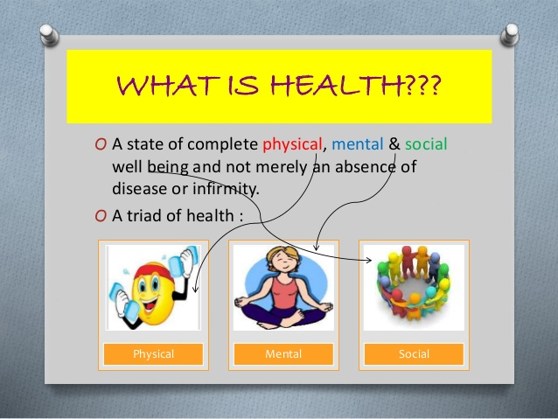

Slide 8
Types of Diseases
1.Acute disease
2.Chronic Disease
3. Congenital diseases (Present since birth)
4. Acquired diseases (Develop after birth)

Slide 9
Acquired diseases
Diseases can be broadly grouped into
A) Infectious and
B) Non-infectious.
Diseases which are easily transmitted from one person to another, are called infectious diseases

Slide 10
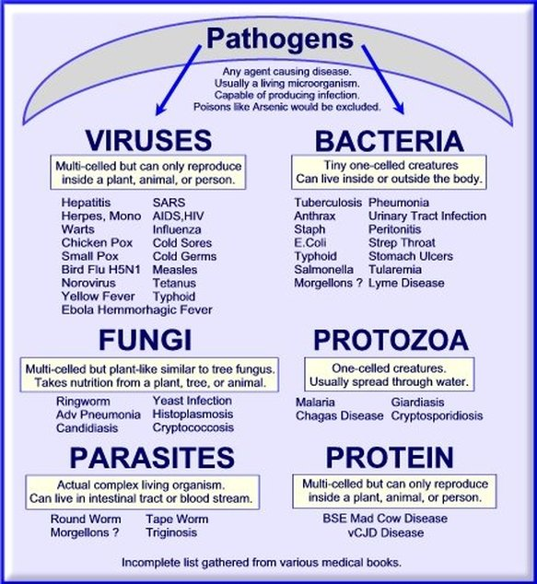

Slide 11
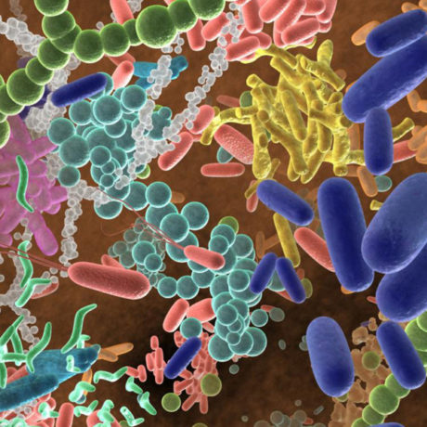

Slide 12
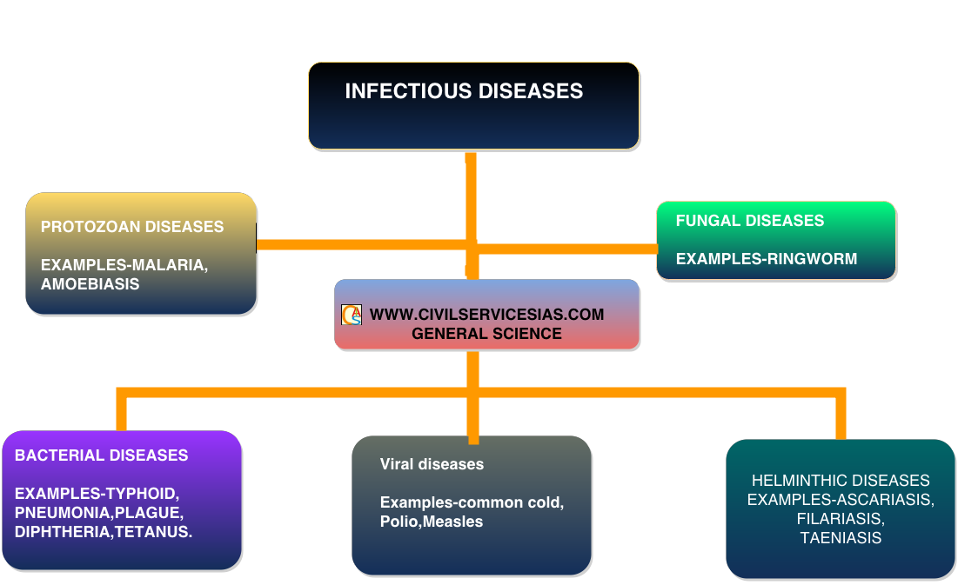

Slide 13
A) Infectious
Disease causing organisms are called pathogens.
On the basis of pathogens ,it can be
  1.Bacterial
  2.Protozoan
  3.Helminthic (elephantiasis or filariasis, ascariasis, taeniasis)
  4.Fungal and
  5.Viral

Slide 14
B) Non-infectious
It can be
1. Degenerative (diseases caused due to malfunctioning of vital body in old age )
2. Deficiency (caused due to lack of nutrients in diet)
2. Allergies (caused due to hypersensitivity of certain foreign substances)
4. Cancer (caused due to uncontrolled growth of cell/ tissues)
5. Metabolic diseases(caused due to metabolic activities)

Slide 15
1.Bacterial Diseases
Typhoid
Pneumonia
Cholera
TB

Slide 16
Typhoid (Mary Mallon nick named
Typhoid Mary)
Salmonella typhi is a pathogenic bacterium which causes typhoid fever in human beings.
These pathogens generally enter the small intestine through food and water contaminated with them and migrate to other organs through blood.
Sustained high fever (39° to 40°C), weakness, stomach pain, constipation, headache and loss of appetite are some of the common symptoms of this disease. Intestinal perforation and death may occur in severe cases. Typhoid fever could be confirmed by Widal test.

Slide 17
Typhoid
Pathogen : A Bacillus rod-shaped bacterium (Salmonella typhi)
Mode of transmission : Through contaminated food and water
Incubation period : About 1-3 weeks
Symptoms
  (i) Continuous fever, headache, slow pulse rate.
  (ii) Reddish rashes appear on the belly.
  (iii) In extreme cases, ulcers may rupture resulting in death of the patient.
Prevention and Cure
  (i) Anti-typhoid inoculation should be given.
  (ii) Avoid taking exposed food and drinks.
  (iii) Proper sanitation and cleanliness should be maintained.
  (iv) Proper disposal of excreta of the patient.
  (v) Antibiotics should be administered.

Slide 18
3. Cholera
It often breaks out among crowded and areas with poor sanitary conditions.
Pathogen : Comma shaped bacterium (Vibrio cholerae)
Mode of transmission : Contaminated food and water. House - fly is the carrier.
Incubation period : 6 hours to 2-3 days.
Symptoms
  (i) Acute diarrohoea, rise watery stool.
  (ii) Muscular cramps.
  (iii) Loss of minerals through urine.
  (iv) Dehydration leads to death.

Slide 19
Cholera
Prevention and cure
  (i) Cholera vaccination should be given.
  (ii) Electrolytes (Na, K, sugar, etc.) dissolved in water should be given to the patient to check dehydration (In market it is available as ORS–oral rehydration solution).
  III.Proper washing and cooking of food
  (iv) Proper disposal of vomit and human excreta.
  (v) Flies should not be allowed to sit on eatables and utensils

Slide 20
Pneumonia
Bacteria like Streptococcus pneumoniae and Haemophilus influenzae are responsible for the disease pneumonia .
Which infects the alveoli of the lungs.
As a result of the infection, the alveoli get filled with fluid leading to severe problems in respiration.
The symptoms of pneumonia include fever, chills, cough and headache. In severe cases, the lips and finger nails may turn gray to bluish in colour.

Slide 21
Other Bacterial Diseases
Dysentery, plague, diphtheria, etc., are some of the other bacterial diseases in man.

Slide 22
Tuberculosis
Pathogen : A bacterium (Mycobacterium tuberculosis).
Mode of Transmission : airborne-discharged through sputum, cough, sneeze, etc of the infected person.
Incubation period : 2-10 weeks during which the bacteria produce a toxin, tuberculin.
Symptoms
  (i) Persistent fever and coughing.
  (ii) Chest pain and blood comes out with the sputum.
  (iii) General weakness.

Slide 23
Tuberculosis
Prevention and Cure
(i) Isolation of patient to avoid spread of infection.
(ii) BCG vaccination is given to children as a preventive measure.
(iii) Living rooms should be airy, neat and with clean sorroundings.
(iv) Antibiotics be administered as treatment

Slide 24
Diphtheria
Etiology: Corynebacterium diphtheriae
Incubation period: 2-5 days
Most common in children less than 10yr
Transmission: close contact with infected secretions and skin lesions
Bacterial toxin affects heart, kidneys, peripheral nerves

Slide 25
Diphtheria
Clinically:
  Fever, malaise
  Breath odor
  Fragile membrane over posterior pharynx and other respiratory surfaces
  Symptoms of cardiac, renal, peripheral nervous systems

Slide 26
Diphtheria
This disease generally occurs in children of 1-5 years of age.
Pathogen : Rod-shaped bacterium (Cornybacterium diphtherea)
Mode of Transmission : Through air (droplet infection)
Incubation period : 2-4 days
Symptoms
  (i) Slight fever, Sore throat and general indisposition.
  (ii) Oozing semisolidmaterial in the throat which develops into a toughmembrane.
The membrane may cause clogging (blocking) of air passage.

Slide 27
Diphtheria cont.
Prevention and cure
  (i) Immediate medical attention should be given.
  (ii) Babies should be given DPT vaccine.
  (iii) Sputum, oral and nasal discharges of the infected child should be disposed off.
  (iv) Antibiotics may be given under doctor’s supervision.
  (v) Isolation of the infected child.

Slide 28
Leprosy
Pathogen : A bacterium (Mycobacterium leprae)
Mode of transmission : Prolonged contact with the infected person. Nasal secretions are the most likely infectious material for family contacts.
Incubation period : 1-5 years
Symptoms
  (i) Affects skin.
  (ii) Formation of nodules and ulcer.
  (iii) Scabs and deformities of fingers and toes.
  (iv) Infected areas lose sensation.
Prevention and Cure
  (i) The children should be kept away from parents suffering from leprosy.
  (ii) Some medicine may arrest the disease and prevent from spreading

Slide 29
Viruses cause diseases
Rhino viruses represent one such group of viruses which cause one of the most infectious human ailments – the common cold.
They infect the nose and respiratory passage but not the lungs.
The common cold is characterized by nasal congestion and discharge, sore throat, hoarseness, cough, headache, tiredness, etc., which usually last for 3-7 days.
Droplets resulting from cough or sneezes of an infected person are either inhaled directly or transmitted through contaminated objects such as pens, books, cups, doorknobs, computer keyboard or mouse, etc., and cause infection in a healthy person.

Slide 30
Chicken pox
Pathogen : Chicken pox virus (Varicella)
Mode of transmission : By contact or through scabs
Incubation period : 12-20 days
Symptoms
  (i) Fever, headache and loss of appetite
  (ii) Dark red-coloured rash on the back and chest which spreads on the whole body. Later, rashes change into vessicles.

Slide 31
Chicken pox
  (iii) After few days these vessicles start drying up and scabs (crusts) are formed.
  (v) These scabs start falling (infective stage)
Prevention and cure
There is no vaccine against chicken pox as yet. But precautions must be taken as follows:
  (i) The patient should be kept in isolation.
  (ii) Clothings, utencils, etc. used by the patient should be sterilised.
  (iii) Fallen scabs should be collected and burnt.
One attack of chicken pox gives life long immunity to the person recovered from the disease.

Slide 32
Hepatitis
Pathogen : Hepatitis B virus.
Mode of Transmission : Mainly through contaminated water.
Incubation Period : Generally 15-160 days.
Symptoms
  (i) Bodyache.
  (ii) Loss of appetite and nausea.
  (iii) Eyes and skin become yellowish, urine deep yellow in colour (due to bile pigments).
  (iv) Enlarged liver.
Prevention and Cure
  (i) Hepatitis B vaccine is now available in India.
  (ii) Proper hygeine is to be observed.
  (iii) Avoid taking fat rich substances.

Slide 33
Influenza
Influenza, commonly known as ‘flu’ is an illness caused by viruses that infect the respiratory tract. Compared to common cold, influenza is a more severe illness.
Causes
  Influenza is caused by a virus which attacks our body’s cells, resulting in various symptoms.

Slide 34
Influenza
Symptoms
Typical symptoms of influenza include:
  (i) fever (Usually 100° F to 103° F in adults and often even higher in children).
  (ii) respiratory tract infection symptoms such as, cough, sore throat, running nose, headache, pain in the muscles, and extreme fatigue.
Although nausea and vomiting and diarrhoea can sometimes accompany Influenza infection, especially in children, gastrointestinal symptoms are rarely prominent.
Treatment and Control
  (i) Much of the illness and death caused by influenza can be prevented by annual influenza vaccination. Influenza vaccine is specifically recommended for those who arc at high risk for complications with chronic diseases of the heart, lungs or kidneys, diabetes, or severe forms of anemia.
  (ii) The persons suffering from influenza should
Drink plenty of fluids and relief with paracetamol and aspirin .

Slide 35
Dengue or Break bone Fever
Dengue is an acute fever caused by virus. It is of two types:
  (i) Dengue fever,
  (ii) Dengue hemorrhagic fever.
Dengue fever is characterized by an onset of sudden high fever, severe headache, pain behind the eyes and in the muscles and joints.
Dengue hemorrhagic fever is an acute infectious viral disease. It is an advanced stage of dengue fever. It is characterized by fever during the initial phase.
Symptoms
  Headache,
  Pain in the eye,
  Joint pain and muscle pain,
  Signs of bleeding,
  Red tiny spots on the skin, and
  Bleeding from nose and gums.
How does Dengue spread?
Dengue spreads through the bite of an infected Aedes aegypti mosquito.
Vaccine-CYD-TDV in brand name Dengvaxia and made by Sanofi Pasteur.
Also called Dandy fever and break bone fever by Benjamin Rush, Dengue Shock Syndrome

Slide 36
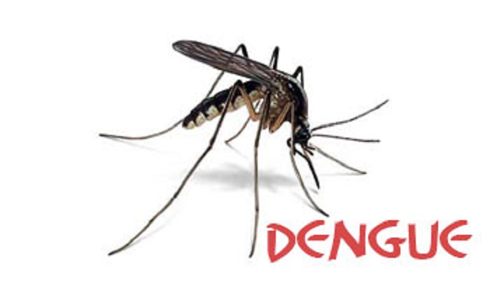

Slide 37
Dengue
Virus to the healthy person and the person becomes infected with dengue. The first symptoms of the disease occur about 5 to 7 days after the infected bite.
Aedes mosquito rests indoors, in closets and other dark places, and is active during day time. Outside, it rests where it is cool and shaded. The female mosquito lays her eggs in stagnant water containers such as coolers, tyres, empty buckets etc., in and around homes, and other areas in towns or villages. These eggs become adults in about 10 days.
Incubation period
The time between the bite of a mosquito carrying dengue virus and the start of symptoms averages 4 to 6 days, with a range of 3 to 14 days.
Diagnosis
Diagnosis is made through blood tests by scanning for antibodies against dengue viruses. In addition the blood platelets counts also drastically reduce in the infected person.

Slide 38
Dengue
Symptoms of Dengue fever
  (i) Sudden onset of high fever, generally 104-105 °F (40 °C), which may last 4- 5 days.
  (ii) Severe headache mostly in the forehead.
  (iii) pain in the joints and muscles, body aches.
  (iv) Pain behind the eyes which worsens with eye movement.
  (v) Nausea or vomiting.
Symptoms of Dengue hemorrhagic fever
  (i) Severe and continuous pain in the abdomen.
  (ii) Rashes on the skin.
  (iii) Bleeding from the nose, mouth, or in the internal organs.
  (iv) Frequent vomiting with or without blood.
  (v) Black stools due to internal bleeding.
  (vi) Excessive thirst (dry mouth).
  (vii) Pale, cold skin, weakness.
Prevention
  (i) Avoid water stagnation for more than 72 hours so that the mosquitoes do not breed there.
  (ii) Prevent mosquito breeding in stored water bodies, like ponds, wells etc.

Slide 39
Dengue
(iii) Destroy discarded objects like old tyres, bottles, etc. as they collect and store
rain water.
(iv) Use mosquito repellents and wear long sleeved clothes to curtail exposure.
(v) Use mosquito nets, also during daytime.
(vi) Avoid outdoor activities during dawn or dusk when these mosquitoes are most
active.
(vii) Patients suffering from dengue fever must be isolated for at least 5 days.
(viii)Report to the nearest health centre for any suspected case of Dengue fever.
Treatment for dengue and dengue hemorrhagic fever
There is no specific treatment for dengue fever. Persons with dengue fever should
rest and drink plenty of fluids. Dengue hemorrhagic fever is treated by replacing
lost fluids. Some patients need blood transfusions to control bleeding.

Slide 40
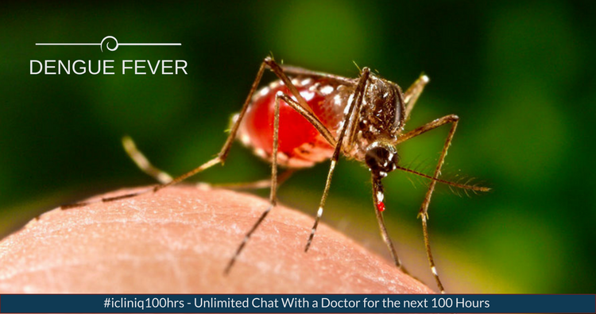

Slide 41
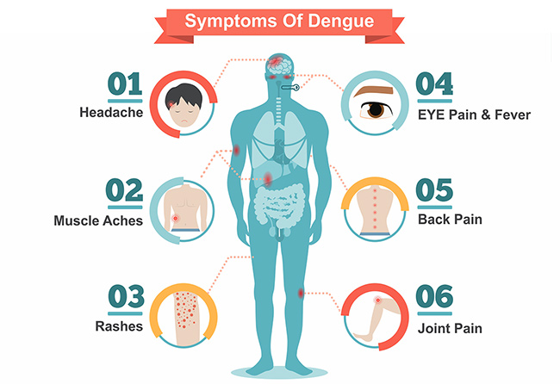

Slide 42
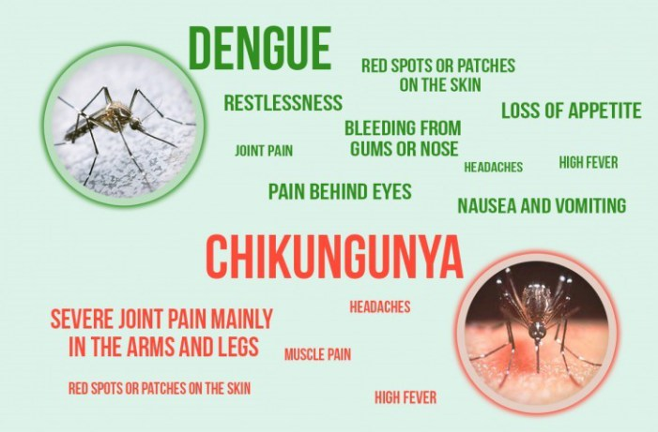

Slide 43
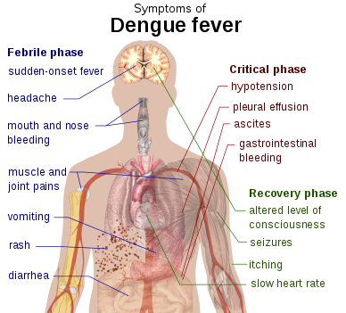

Slide 44
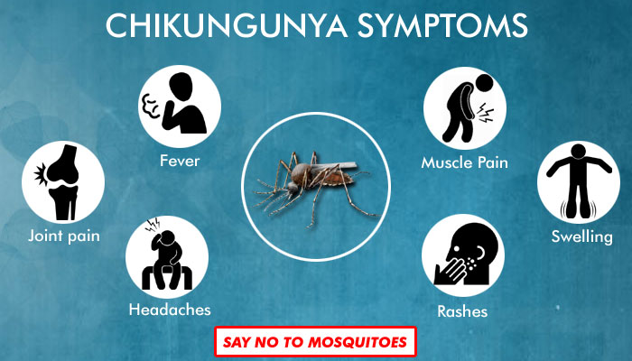

Slide 45
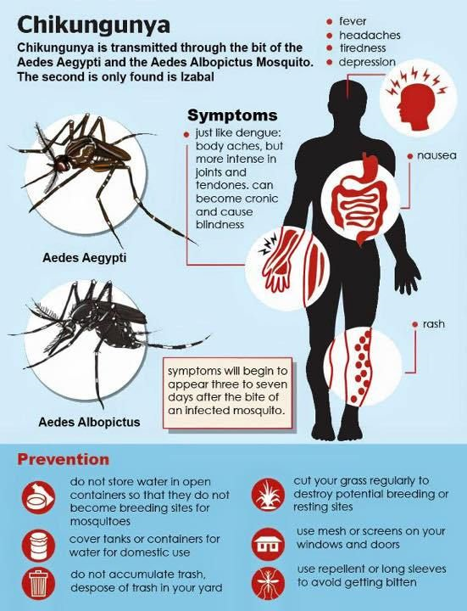

Slide 46
Protozoal disease
Malaria, a disease man has been fighting since many years
Plasmodium, a pathogen a tiny protozoan is responsible for this disease.
Different species of Plasmodium
  P. vivax,
  P. ovale
  P. malaria and
  P. falciparum
  Of these, malignant malaria caused by P. falciparum is the most serious one and can even be fatal.

Slide 47
Malaria
Pathogen : Malarial parasite (different species of Plasmodium)
Mode of transmission : By bite of female Anopheles mosquitoes
Incubation period : Approximately 12 days
Symptoms
  (i) Headache, nausea and muscular pain.
  (ii) Feeling of chilliness and shivering followed by fever which becomes normal along with sweating after some time.
  (iii) The patient becomes weak and anaemic.
  (iv) If not treated properly secondary complications may lead to death.
Prevention and cure
  (i) Fitting of double door and windows (with “Jali” i.e. wire mesh) in the house to prevent entry of mosquitoes.
  (ii) Use of mosquito net and mosquito repellents.
  (iii) No water should be allowed to collect in ditches or other open spaces to prevent mosquito breeding.
  (iv) Sprinkling of kerosene oil in ditches or other open spaces where water gets collected.
  (v) Antimalarial drugs( Quanin) to be taken.

Slide 48

Malaria

Slide 49
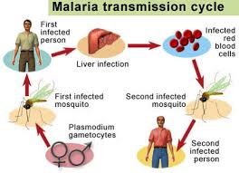

Slide 50
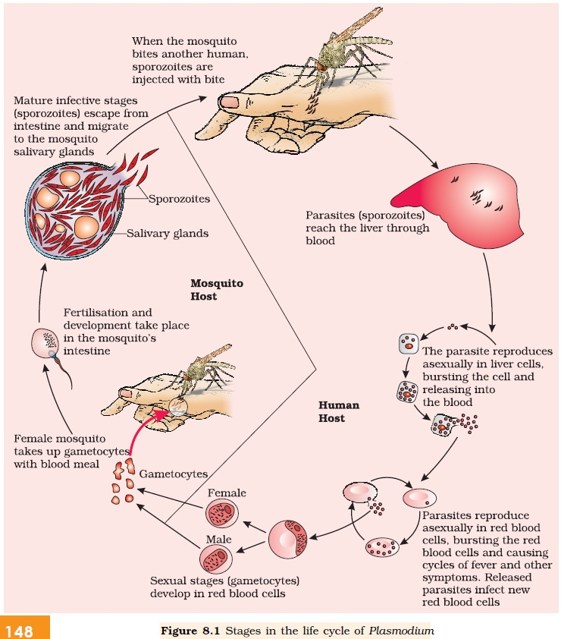

Slide 51
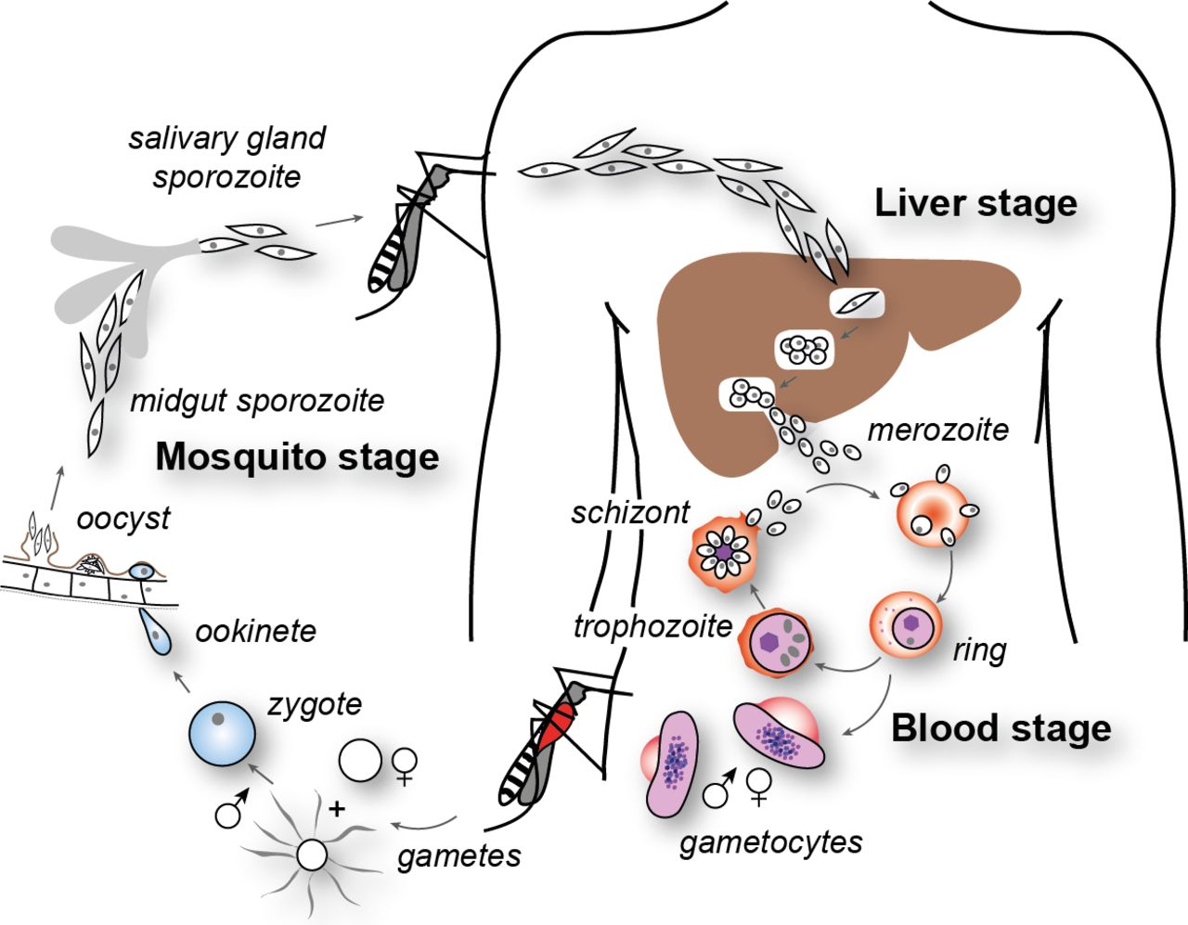

Slide 52
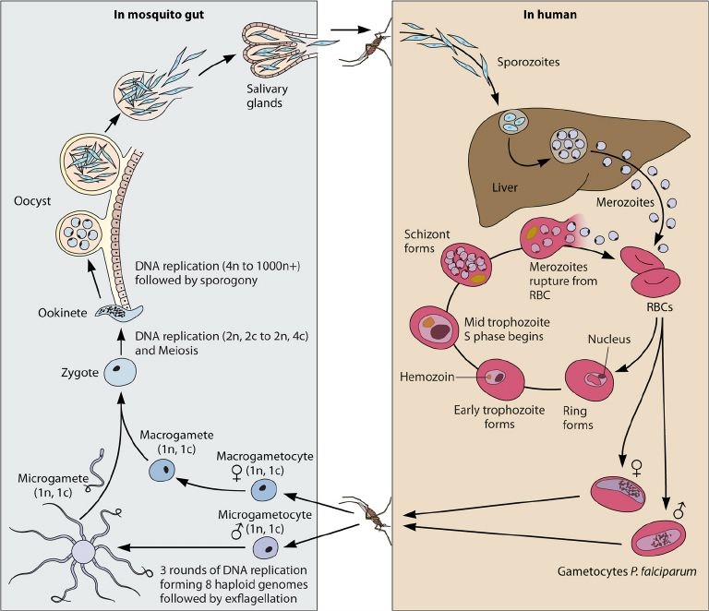

Slide 53
P. vivax
P. vivax
Duration 8 days.
Duration of cycle 48 hr.
Incubation period 14days.
Type and effects –Benign tertian, death rate low

Slide 54
P. malariae
P. malariae
Duration 7-12 days
Duration of cycle 72 hr
Incubation period 18-24days
Type and effects –Quartan, severe

Slide 55
P. ovale
P. ovale
Duration 9 days
Duration of cycle 48 hr
Incubation period 14 days
type and effects –Ovale or mild tertian,severe

Slide 56
P. falaciparum
P. falaciparum
Duration 5-6 days.
Duration of cycle 36-48 hr.
Incubation period 12 days.
Type and effects –Malignant tertian, death rate high.
Of these, malignant malaria caused by Plasmodium falciparum is the most serious one and can even be fatal.

Slide 57
Malaria cont.
Plasmodium enters the human body as sporozoites (infectious form) through the bite of infected female Anopheles mosquito.
The parasites initially multiply within the liver cells and then attack the red blood cells (RBCs) resulting in their rupture.
The rupture of RBCs is associated with release of a toxic substance, haemozoin, which is responsible for the chill and high fever recurring every three to four days.
When a female Anopheles mosquito bites an infected person, these parasites enter the mosquito’s body and undergo further development.
The parasites multiply within them to form sporozoites that are stored in their salivary glands.
When these mosquitoes bite a human, the sporozoites are introduced into his/ her body, thereby initiating the events mentioned above.
It is interesting to note that the malarial parasite requires two hosts – human (Primary) and mosquitoes(secondary) – to complete its life cycle (Figure 8.1); the female Anopheles mosquito(sexual) is the vector (transmitting agent) too.

Slide 58
Amoebiasis, Amoebic Dysentry
Pathogen :Entamoeba histolytica
Mode of transmission :
  House fly transmit from faeces of infected person to food and food products.
  Drinking water and food contaminated by the fecal matter.
Symptoms:
  Constipation
  Abdominal pain and cramp
  Stools with exces mucous and blood clots.
The parasite secrets a proteolytic enzyme CYTOLYSIN that erodes the mucuos membrane of the intestine.

Slide 59
Helminthic
Ascaris, the common round worm and Wuchereria, the filarial worm, are some of the helminths which are known to be pathogenic to man.
Ascaris, an intestinal parasite causes ascariasis.
Symptoms of these disease
include internal bleeding, muscular pain, fever, anemia and blockage of the intestinal passage.
The eggs of the parasite are excreted along with the faeces of infected persons which contaminate soil, water, plants, etc.
A healthy person acquires this infection through contaminated water, vegetables, fruits, etc.

Slide 60
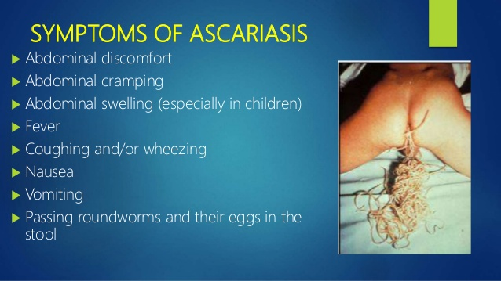

Slide 61
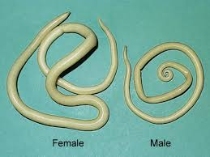

Slide 62
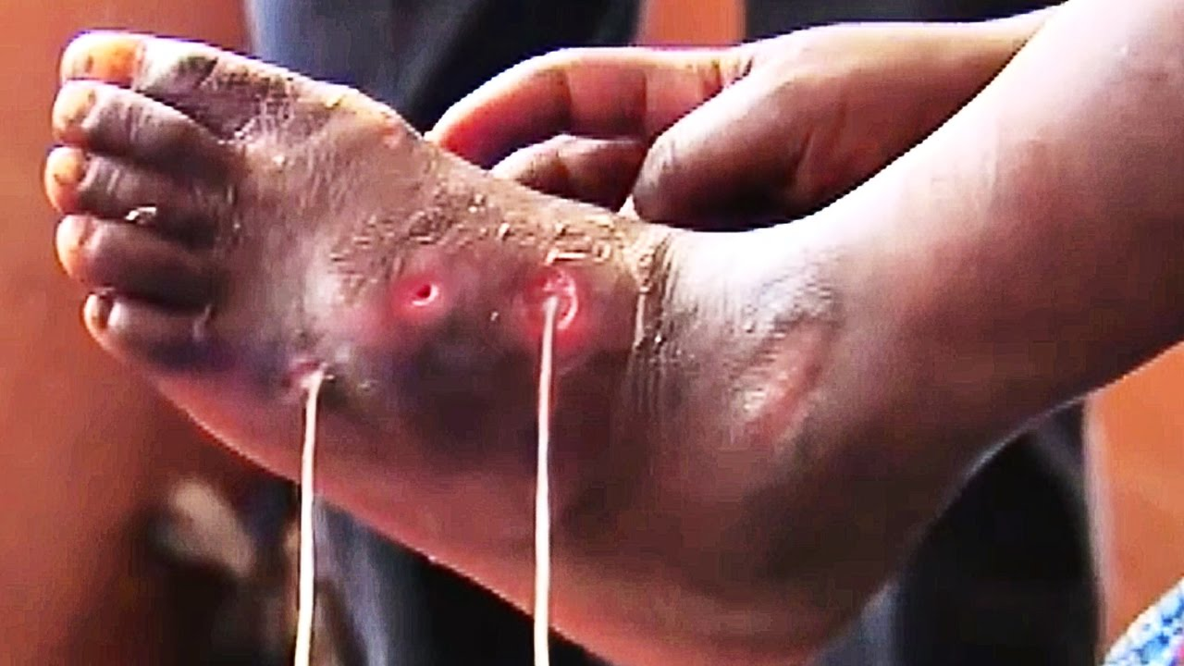

Slide 63
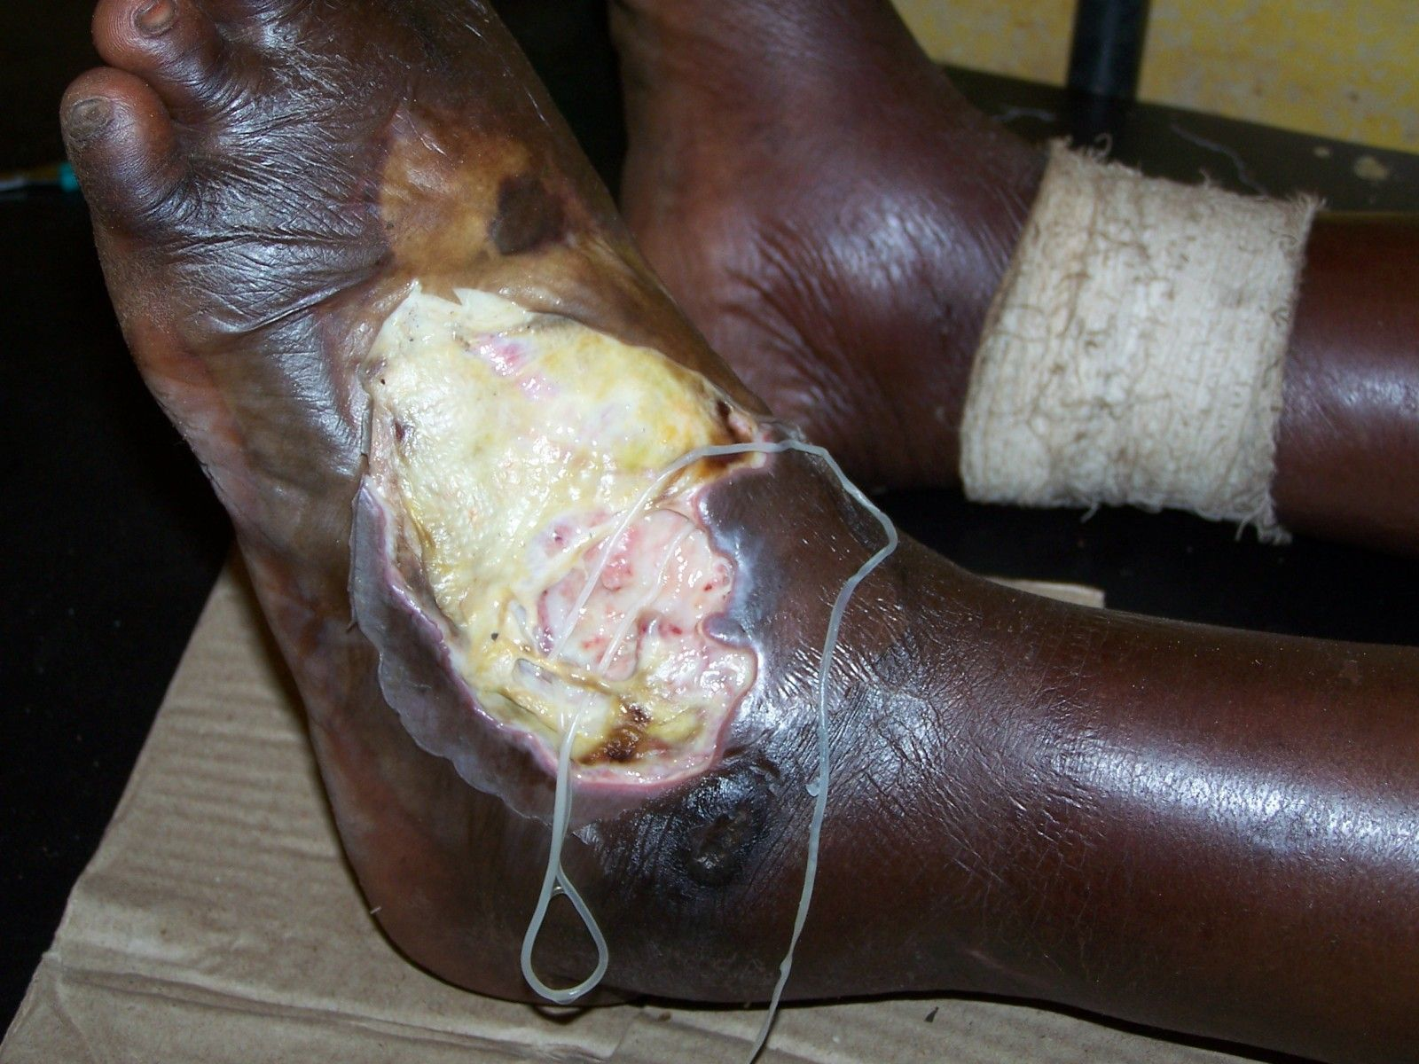

Slide 64
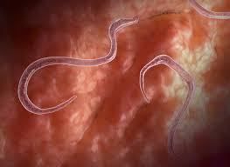

Slide 65
Elephantiasis or filariasis
Wuchereria (W. bancrofti and W. malayi), the filarial worms cause a slowly developing chronic inflammation of the organs in which they live for many years, usually the lymphatic vessels of the lower limbs and the disease is called elephantiasis or filariasis (Figure 8.2).
The genital organs are also often affected, resulting in gross deformities.
The pathogens are transmitted to a healthy person through the bite by the female mosquito vectors.

Slide 66
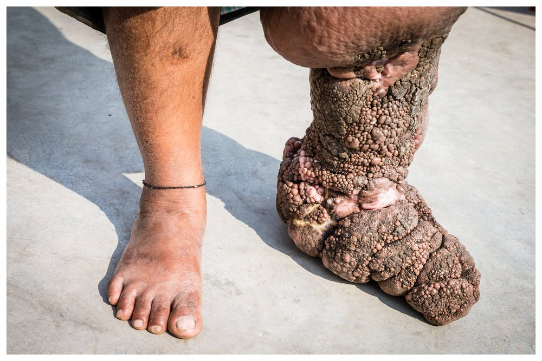

Slide 67
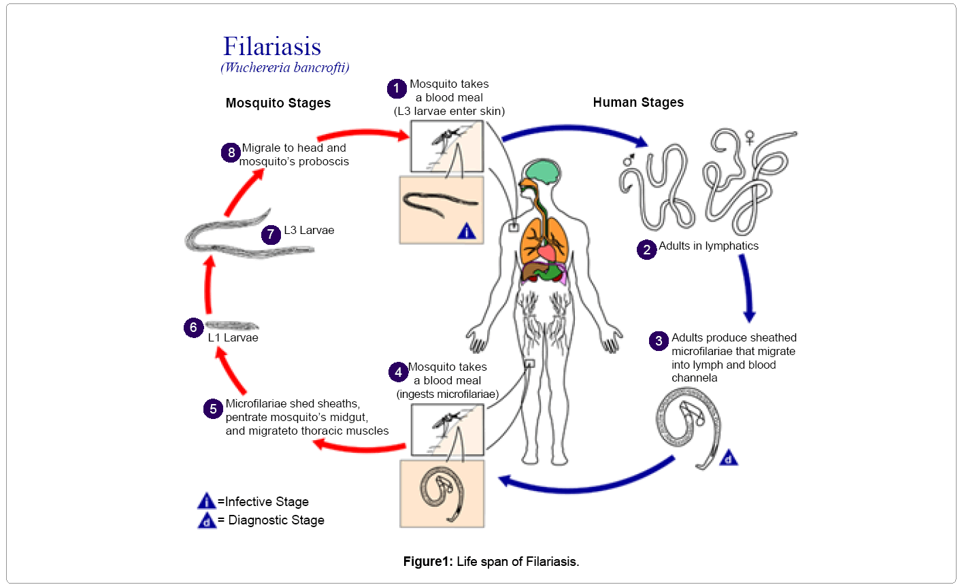

Slide 68
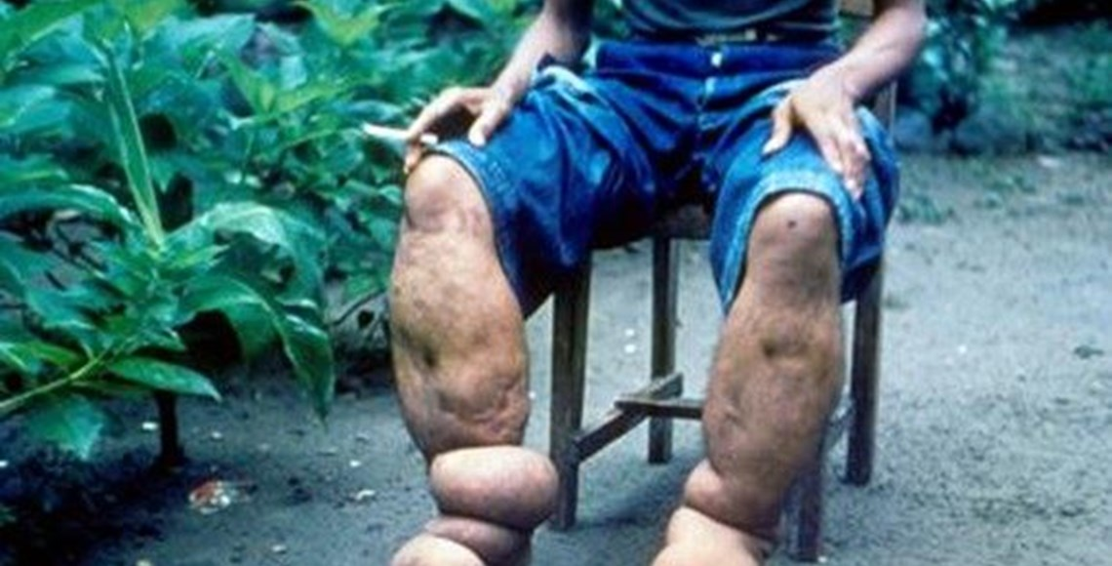

Slide 69
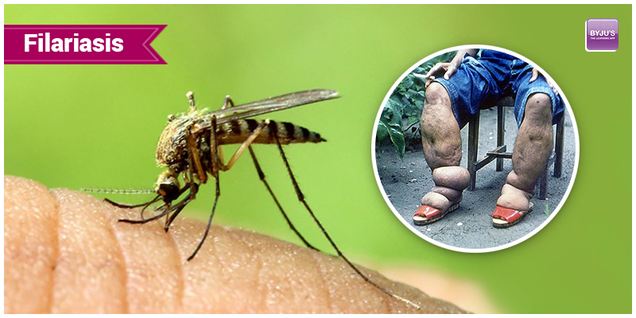

Slide 70
Fungal disease
Many fungi belonging to the genera Microsporum, Trichophyton and Epidermophyton are responsible for ringworms which is one of the most common infectious diseases in man.
Appearance of dry, scaly lesions on various parts of the body such as skin, nails and scalp (Figure 8.3) are the main symptoms of the disease.
These lesions are accompanied by intense itching. Heat and moisture help these fungi to grow, which makes them thrive in skin folds such as those in the groin or between the toes.
Ringworms are generally acquired from soil or by using towels, clothes or even the comb of infected individuals.

Slide 71
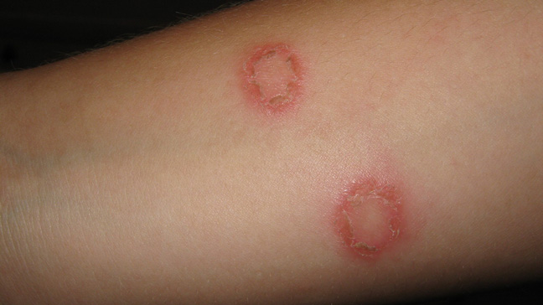

Slide 72
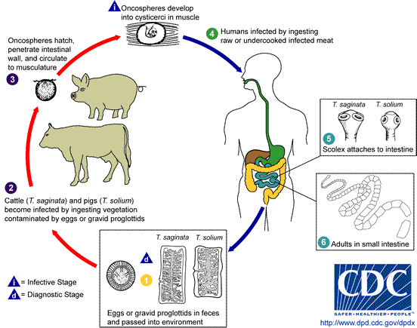

Slide 73
Prevention of disease
Maintenance of personal and public hygiene is very important for prevention and control of many infectious diseases.
Measures for personal hygiene include keeping the body clean; consumption of clean drinking water, food, vegetables, fruits, etc.
Public hygiene includes proper disposal of waste and excreta; periodic cleaning and disinfection of water reservoirs, pools, cesspools and tanks and observing standard practices of hygiene in public catering.
These measures are particularly essential where the infectious agents are transmitted through food and water such as typhoid, amoebiasis and ascariasis. In cases of air-borne diseases such as pneumonia and common cold, in addition to the above measures, close contact with the infected persons or their belongings should be avoided.

Slide 74
Prevention cont.
For diseases such as malaria and filariasis that are transmitted through insect vectors, the most important measure is to control or eliminate the vectors and their breeding places.
This can be achieved by avoiding stagnation of water in and around residential areas, regular cleaning of household coolers, use of mosquito nets, introducing fishes like Gambusia in ponds that feed on mosquito larvae, spraying of insecticides in ditches, drainage areas and swamps, etc.
In addition, doors and windows should be provided with wire mesh to prevent the entry of mosquitoes.
Such precautions have become all the more important especially in the light of recent widespread incidences of the vector-borne (Aedes mosquitoes) diseases like dengue and chikungunya in many parts of India.

Slide 75
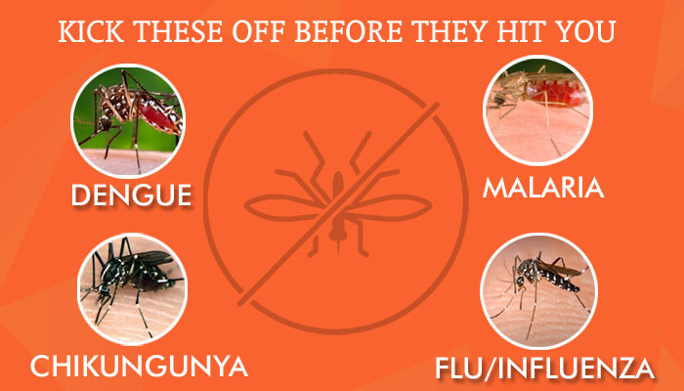

Slide 76
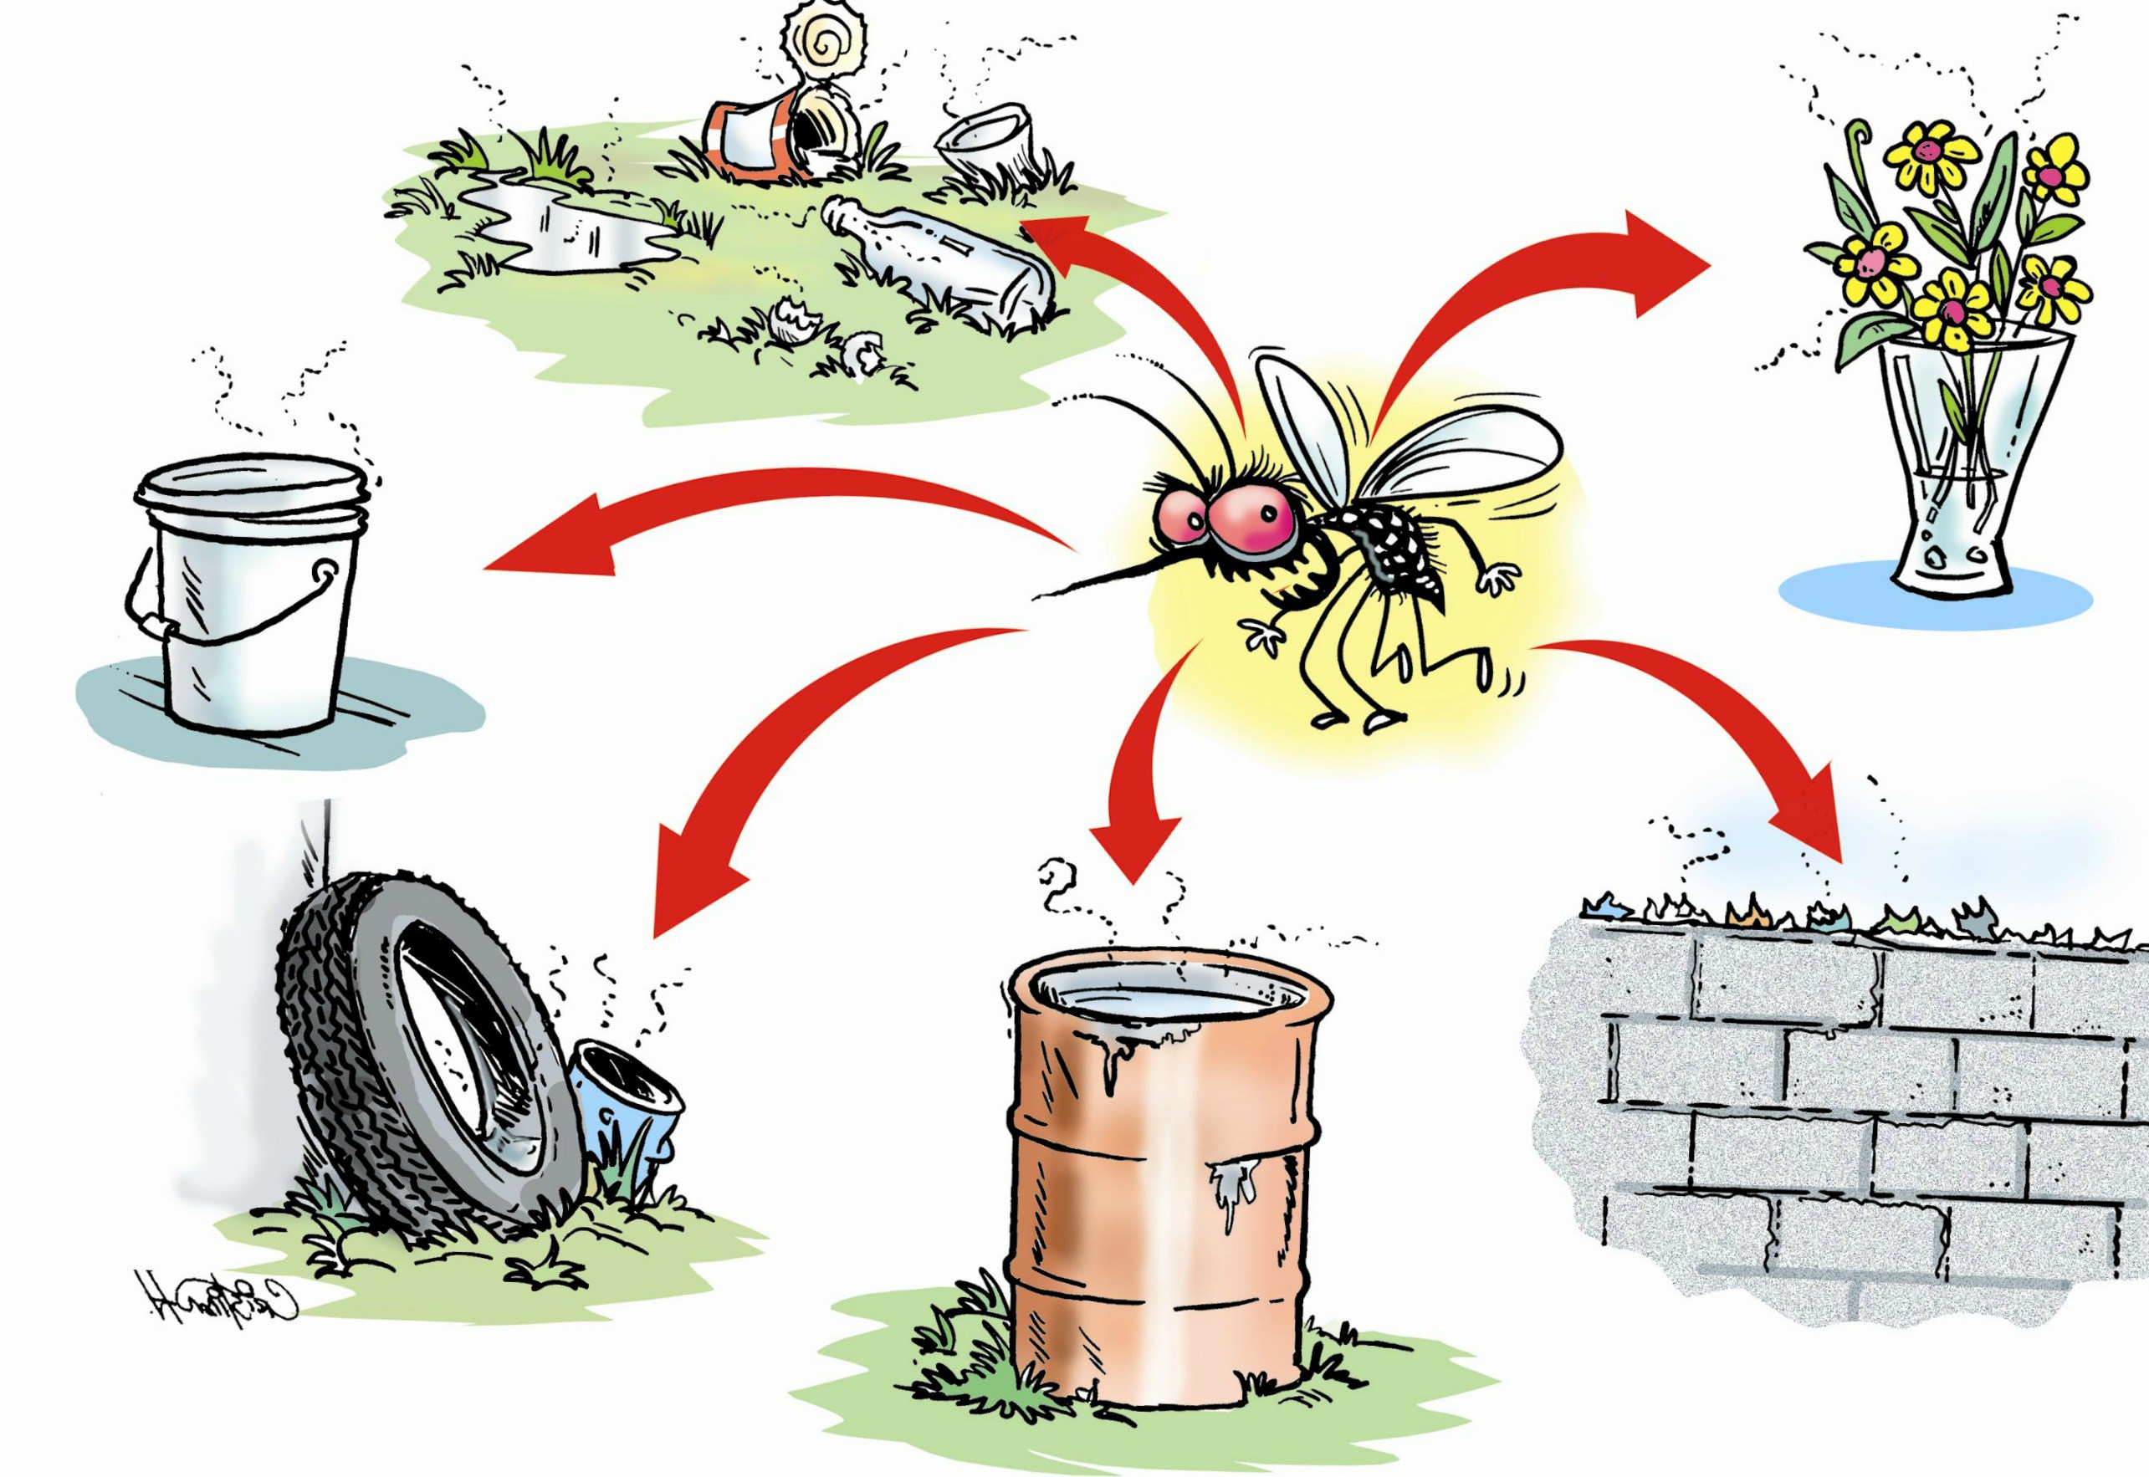

Slide 77
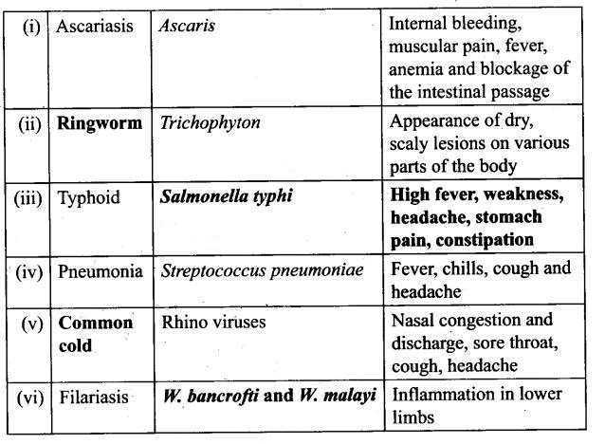

Slide 78
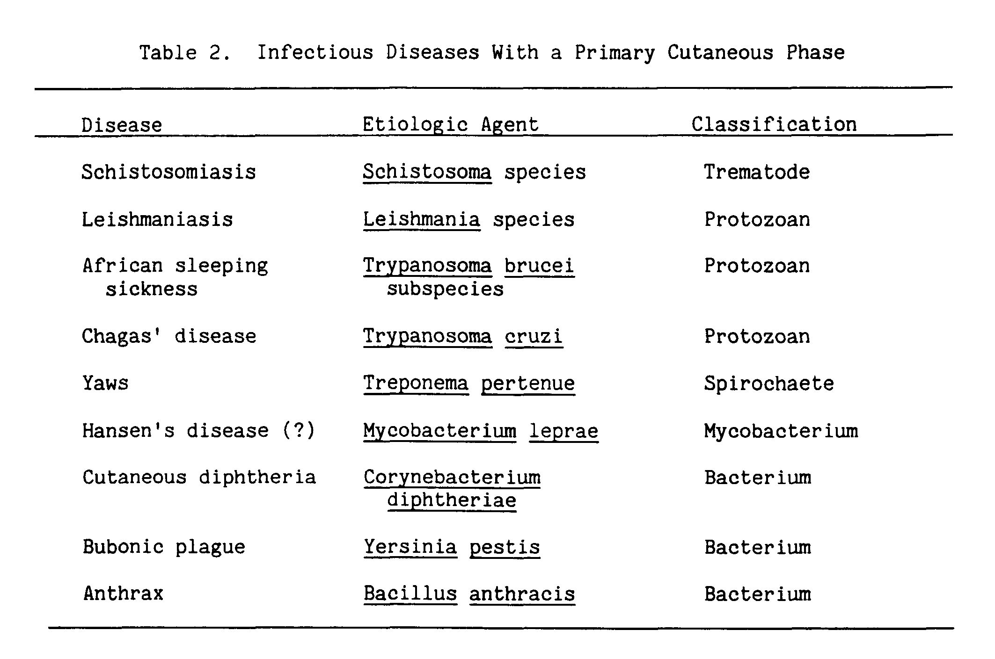

Slide 79
IMMUNE SYSTEM
HUMAN HEALTH AND DISEASE

Slide 80
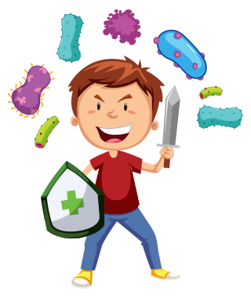

Slide 81
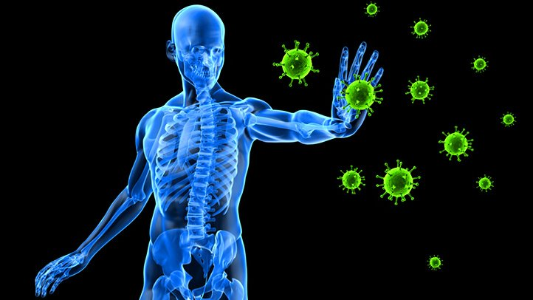

Slide 82
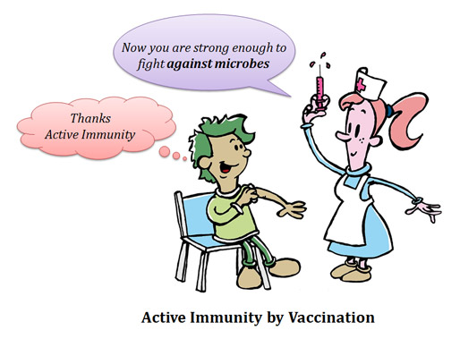

Slide 83
Immunity
This overall ability of the host to fight the disease-causing organism, conferred by the immune system is called immunity.
Immunity is of two types:
  (i) Innate immunity and
  (ii) Acquired immunity.

Slide 84
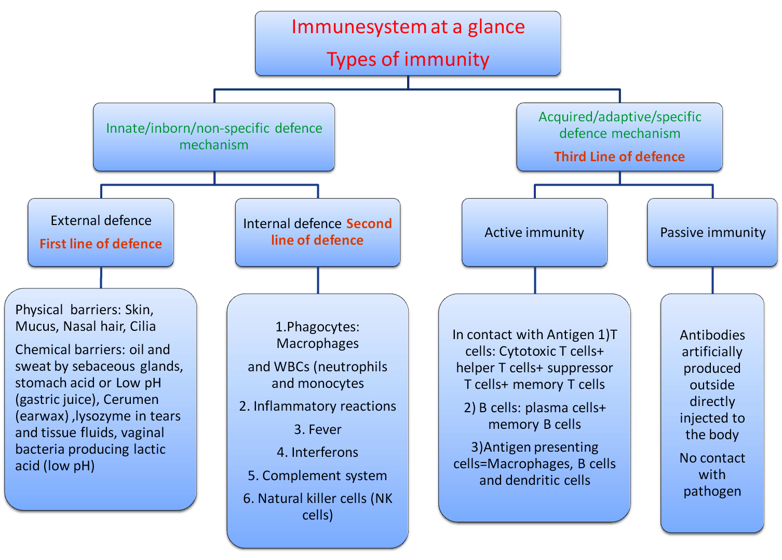

Slide 85
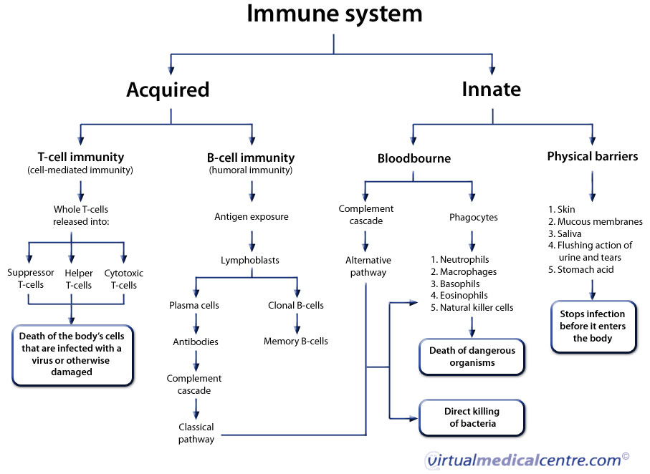

Slide 86
Innate Immunity
Innate immunity is non-specific type of defence, that is present at the time of birth.
This is accomplished by providing different types of barriers to the entry of the foreign agents into our body. Innate immunity consist of four types of barriers. These are —
(i) Physical barriers : Skin on our body is the main barrier which prevents entry of the micro-organisms. Mucus coating of the epithelium lining the respiratory, gastrointestinal and urogenital tracts also help in trapping microbes entering our body.
(ii) Physiological barriers : Acid in the stomach, saliva in the mouth, tears from eyes–all prevent microbial growth.

Slide 87
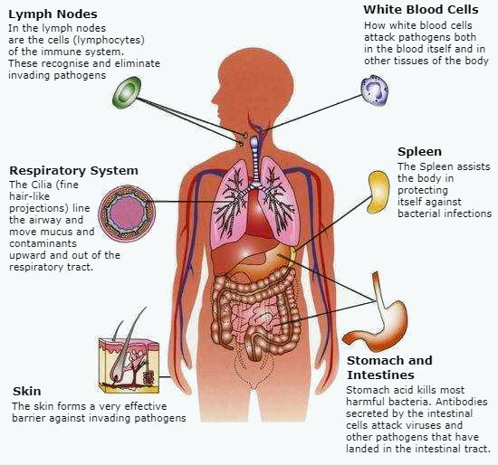

Slide 88
Innate immunity cont.
(iii) Cellular barriers : Certain types of leukocytes (WBC) of our body like polymorpho-nuclear leukocytes (PMNL-neutrophils) and monocytes and natural killer (type of lymphocytes) in the blood as well as macrophages in tissues can phagocytose and destroy microbes.
(iv) Cytokine barriers : Virus-infected cells secrete proteins called interferons which protect non-infected cells from further viral infection.

Slide 89
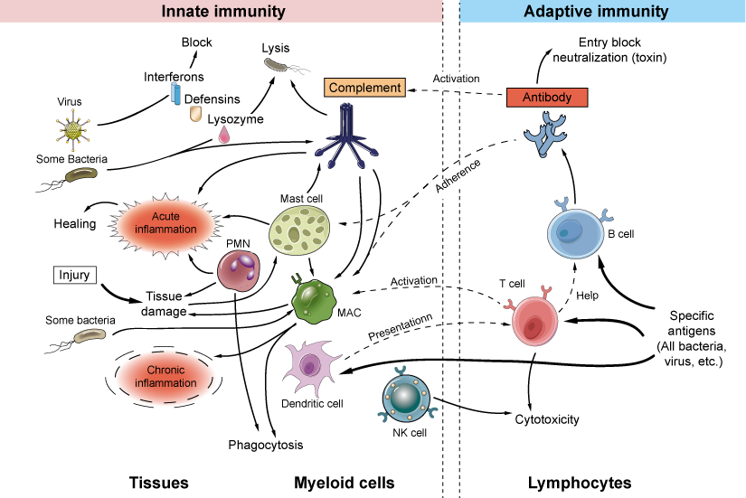

Slide 90
Acquired or Adaptive Immunity
Acquired immunity, on the other hand, is pathogen specific. It is characterised by memory.
This means that our body when it encounters a pathogen for the first time produces a response called primary response which is of low intensity. Subsequent encounter with the same pathogen elicits a highly intensified secondary or anamnestic response. This is ascribed to the fact that our body appears to have memory of the first encounter.

Slide 91
ANTIBODY
The primary and secondary immune responses are carried out with the help of two special types of lymphocytes present in our blood, i.e., B-lymphocytes and T lymphocytes.
  The B-lymphocytes produce an army of proteins in response to pathogens into our blood to fight with them. These proteins are called antibodies.
  The T-cells themselves do not secrete antibodies but help B cells produce them.
Each antibody molecule has four peptide chains, two small called light chains and two longer called heavy chains. Hence, an antibody is represented as H2L2

Slide 92
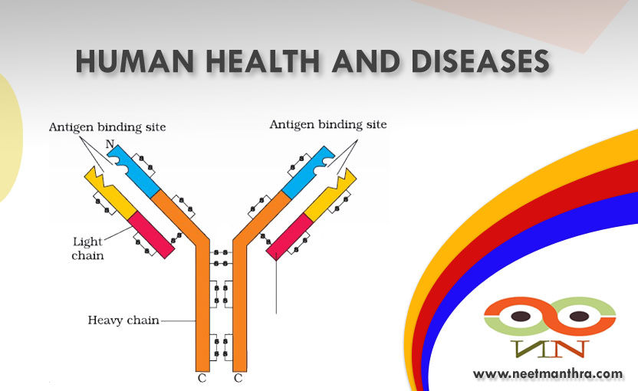

Slide 93
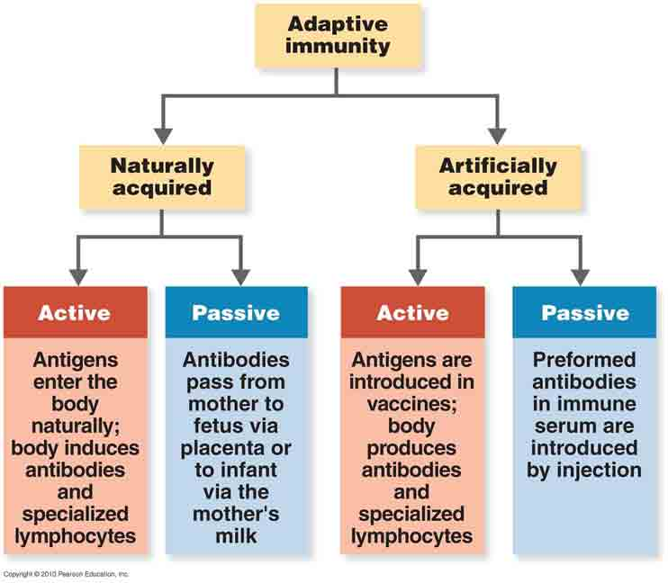

Slide 94
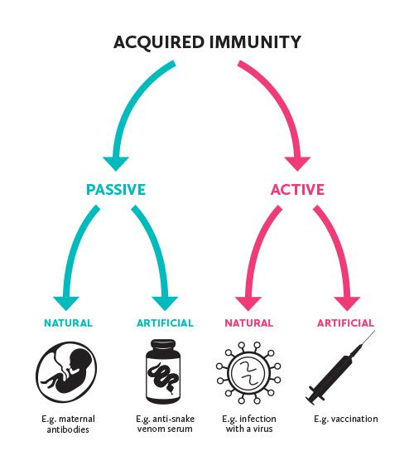

Slide 95
Types of Adaptive immunity Response
Different types of antibodies are produced in our body. IgA, IgM, IgE, IgG are some of them. A cartoon of an antibody is given in Figure 8.4. Because these antibodies are found in the blood, the response is also called as humoral immune response.
  Antibody mediated. The B cells is responsible for that.
  Cell-mediated immune response or cell-mediated immunity (CMI). The T-lymphocytes mediate CMI.

Slide 96
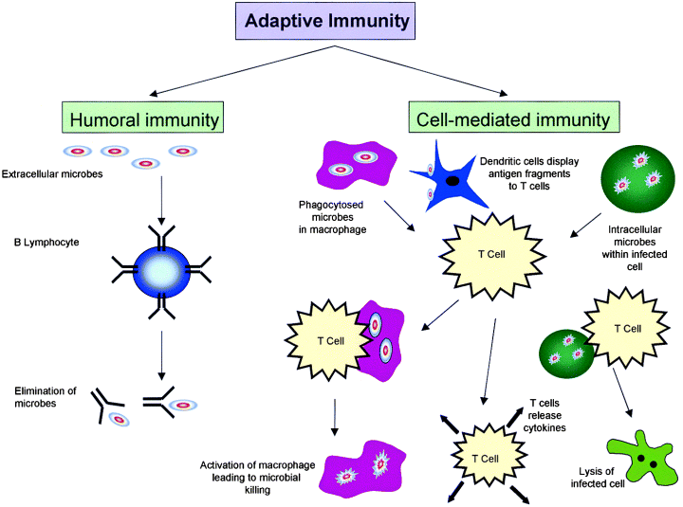

Slide 97
Antibodies
Proteins that recognize and bind to a particular antigen with very high specificity.
Made in response to exposure to the antigen.
Each antibody has at least two identical sites that bind antigen: Antigen binding sites.

Slide 98
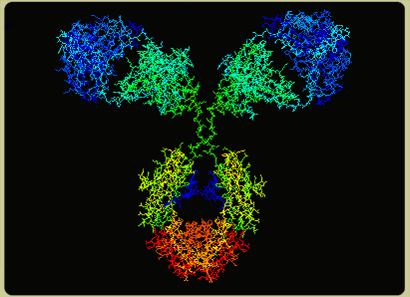
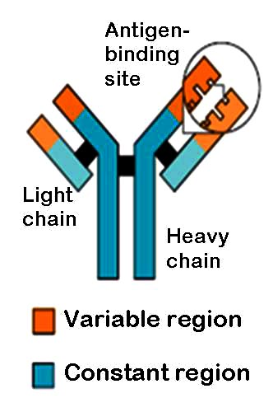
What are Antibodies?
Antibodies ( Immunoglobulin) are a type of glycoprotein produced by B lymphocytes. Antibodies bind antigen with a high degree of specificity and affinity. Antibodies recognize a variety of three-dimensional shapes (amino acids, lipids, carbohydrates, etc).

Slide 99
Antibodies
Valence of an antibody: Number of antigen binding sites. Most are bivalent.
Belong to a group of serum proteins called immunoglobulins (Igs).

Slide 100
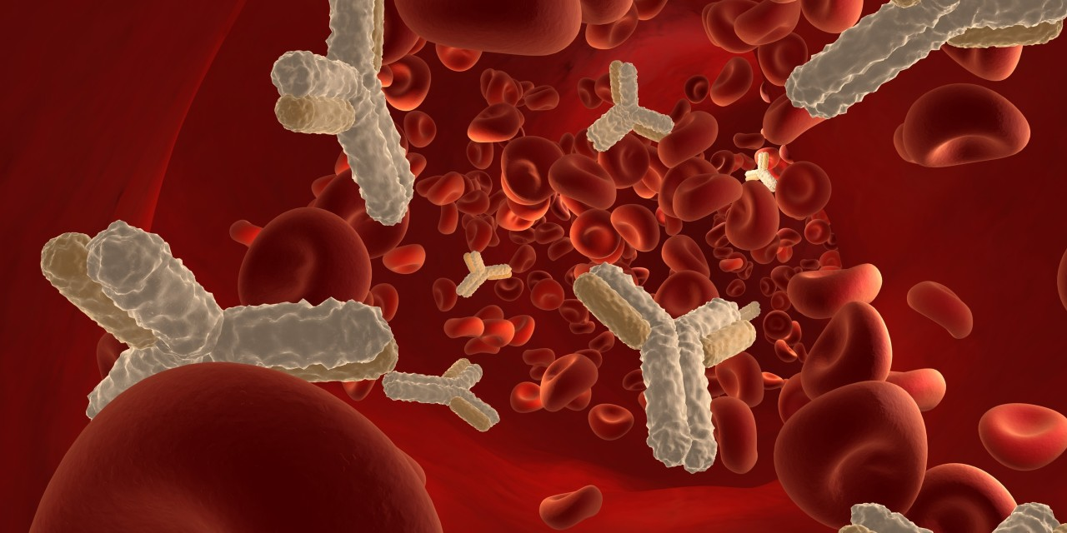

Slide 101
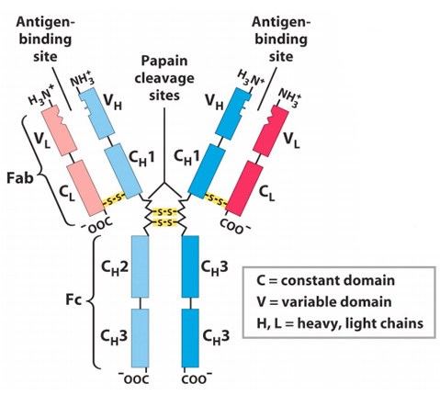

Slide 102
Antibodies or Immunoglobulins
* Five classes of Antibodies:
  IgG
  IgM
  IgA
  IgD
  IgE

Slide 103
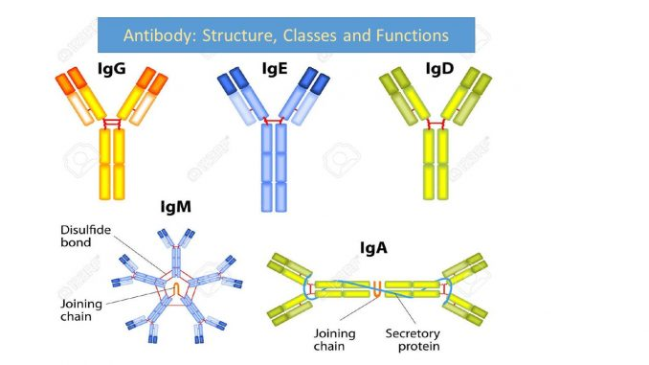
Immunoglobulins

Slide 104
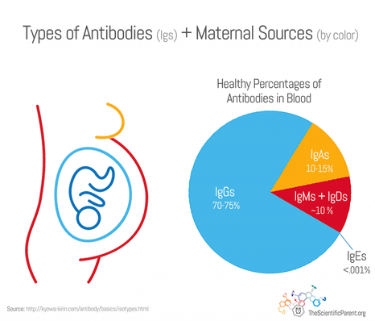

Slide 105
Antibody Structure
Immunoglobulins are glycoproteins made up of:
- Four polypeptide chains (IgG):
a) Two light (L) polypeptide chains
b) Two heavy (H) polypeptide chains
- The four chains are linked by disulfide bonds
- Terminal portion of L-chain contains part of antigen binding site
- H-chains are distinct for each of the five Immunoglobulins
- Terminal portion of H-chain participate in antigen binding site
- The other (Carboxyl) terminal portion forms Fc fragment

Slide 106
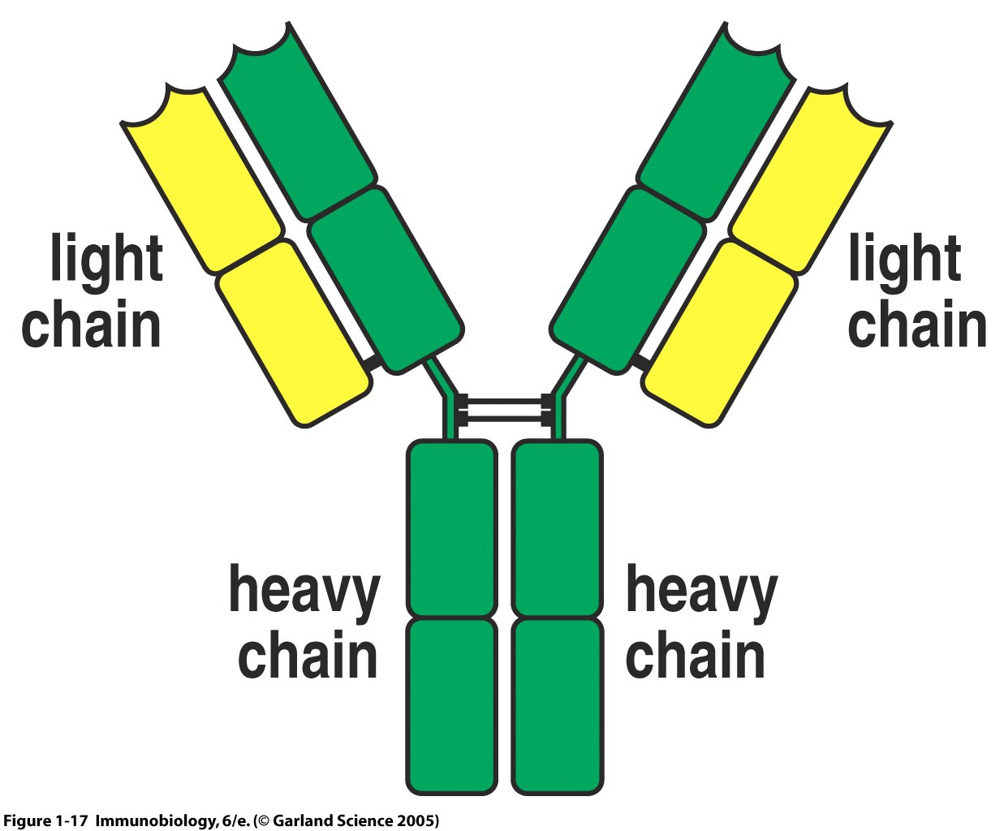
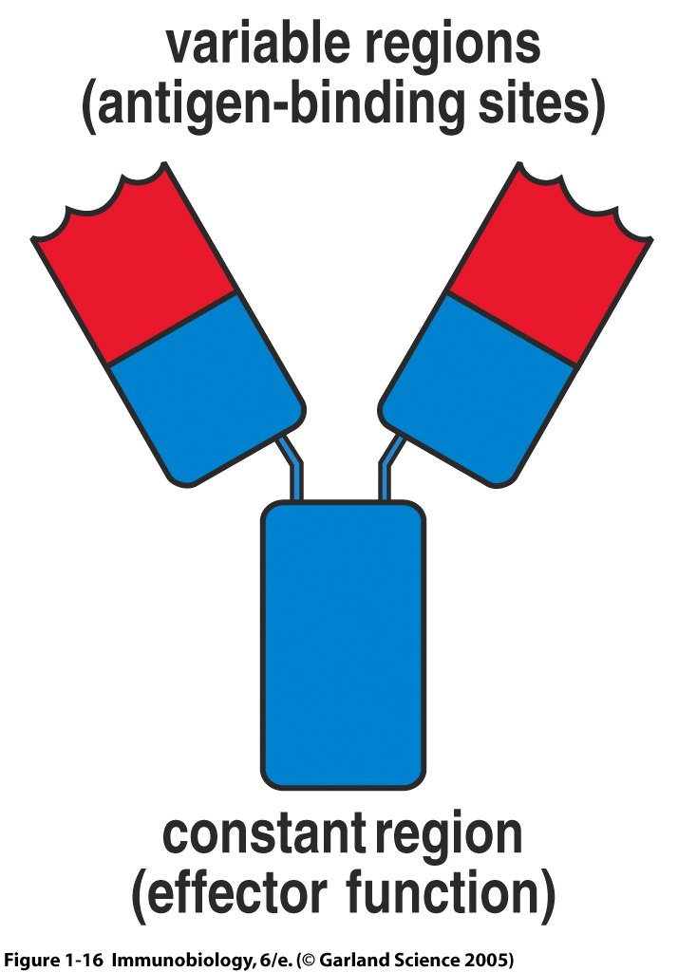
ANTIBODY STRUCTURE
An antibody molecule is composed of two identical Ig heavy chains (H) and two identical light chains (L), each with a variable region (V) & constant region (C).

Slide 107
Variable (V) and Constant (C) Regions
- Each H-chain and each L-chain has V-region and C-region
- V-region lies in terminal portion of molecule
- V-region shows wide variation in amino a. sequences
- Responsible for the antigen binding.
- C-region lies in carboxyl or terminal portion of molecule
- C-region shows an unvarying amino acid sequence
- It is responsible for biologic functions

Slide 108
ANTIBODY STRUCTURE
The unique structural architecture of antibodies allows multiple, highly diverse antigens to induce identical effector functions.
Antigen
Variable region
Constant region
IMMUNITY
IMMUNITY
IMMUNITY
Different variable regions bind different antigens. Identical constant regions induce identical responses.

Slide 109
Immunoglobulin Classes
I. IgG
Structure: Monomer
Percentage serum antibodies: 80%
Location: Blood, lymph, intestine
Half-life in serum: 23 days
Complement Fixation: Yes
Placental Transfer: Yes
Known Functions: Enhances phagocytosis, neutralizes toxins and viruses, protects fetus and newborn.

Slide 110
Antibody Classes And Biological Activities
IgG
  Most abundant immunoglobin 80% of serum Ig
  ~10mg/mL
  IgG1,2,3,4 (decreasing serum concentration)
  IgG1, IgG3 and IgG4 cross placenta
  IgG3 Most effective complement activator
  IgG1 and IgG3 High affinity for FcR on phagocytic cells, good for opsonization

Slide 111
Immunoglobulin Classes
II. IgM
Structure: Pentamer
Percentage serum antibodies: 5-10%
Location: Blood, lymph, B cell surface (monomer)
Half-life in serum: 5 days
Complement Fixation: Yes
Placental Transfer: No
Known Functions: First antibodies produced during an infection. Effective against microbes and agglutinating antigens.

Slide 112
Antibody Classes And Biological Activities
IgM
  5-10% of serum immunoglobulin
  1.5mg/mL
  mIgM (also IgD) expressed on B-cells as BCR
  Pentameric version is secreted
  First Ig of primary immune response
  High valence Ig (10 theoretical), 5 empirical
  More efficient than IgG in complement activation

Slide 113


Slide 114
Immunoglobulin Classes
III. IgA
Structure: Dimer
Percentage serum antibodies: 10-15%
Location: Secretions (tears, saliva, intestine, milk), blood and lymph.
Half-life in serum: 6 days
Complement Fixation: No
Placental Transfer: No
Known Functions: Localized protection of mucosal surfaces. Provides immunity to infant digestive tract.

Slide 115
Antibody Classes And Biological Activities
IgA
  10-15% of serum IgG
  Predominant Ig in secretions
    Milk, saliva, tears, mucus
  5-15 g of IgA released in secretions!!!!
  Serum mainly monomeric, polymers possible not common though
  Secretions, as dimer or tetramer+J-chain polyptetide+secretory component (Poly IgR)

Slide 116
Immunoglobulin Classes
IV. IgD
Structure: Monomer
Percentage serum antibodies: 0.2%
Location: B-cell surface, blood, and lymph
Half-life in serum: 3 days
Complement Fixation: No
Placental Transfer: No
Known Functions: In serum function is unknown. On B cell surface, initiate immune response.

Slide 117
Antibody Classes And Biological Activities
IgD
  Expressed on B-cell Surface
IgM and IgD, Expressed on B-cell Surface
We Do Not Know Any Other Biological Effector Activity
Low serum concentrations, ~30μg/mL

Slide 118
Immunoglobulin Classes
V. IgE
Structure: Monomer
Percentage serum antibodies: 0.002%
Location: Bound to mast cells and basophils throughout body. Blood.
Half-life in serum: 2 days
Complement Fixation: No
Placental Transfer: No
Known Functions: Allergic reactions. Possibly lysis of worms.

Slide 119
Antibody Classes And Biological Activities
IgE
  Very low serum concentration, 0.3μg/mL
  Participate in immediate hypersensitivities reations. Ex. Asthma,
Binds Mast Cells and Blood Basophils t
Binding causes degranulation (Histamine Release)

Slide 120
B-lymphocytes
Are of two types:
  1.Plasma Cells-produce antibody and acts as a antigen. Helps macrophage cells to kill germ cells.
  2.Memory Cells-not produced any antibody,
  Remain dormant and active when same antigen gets exposed.

Slide 121
T- LYMPHOCYTES
NAME OF THE T CELL | FUNCTION
Helper T cells | Cooperate with B cells( in antibody production) also activate macrophage.
Cytotoxic T cells | Destroy viral infected and tumor cells.
Memory T cells | Potentially cancer fighting T cells and remain after the pathogens have been killed to stop re infection(storing same data)
Suppressor/Regulatory T cells | Basically are the off switch for the immune system and protects healthy cells
Natural Killser T cells | Combine with the antigen on the invading cells and release chemical ( lymphokines ) which kill the pathogens

Slide 122
Grafting
Grafts from just any source – an animal, another primate, or any human beings cannot be made since the grafts would be rejected sooner or later.
Tissue matching, blood group matching are essential before undertaking any graft/transplant and even after this the patient has to take immuno–suppresants all his/her life.
The body is able to differentiate ‘self’ and ‘nonself’ and the cell-mediated immune response is responsible for the graft rejection.

Slide 123
ACTIVE IMMUNITY
The individual has respond to an antigen and produced his own antibodies.
Lymphocytes are activated and the memory cells formed provide long lasting resistance.
An infection is an example of acquiring natural immunity by which body produce the necessary antibodies by B cells.
By vaccination.

Slide 124


Slide 125
Passive immunity
Individual is given antibodies produced by someone else.
Breast feed is providing colostrums ,thick yellowish milk after few days of birth.
Naturally from a mother to her foetus.
Snake antitoxin
Protection by borrowed antibodies.

Slide 126
Difference between Active and Passive Immunity.
Ser | ACTIVE IMMUNITY | PASSIVE IMMUNITY
1 | Own cells produce antibody in response to vaccine and infection | Others antibodies taken
2 | Provides relief after long time period. | Immediate relief
3 | It has no side effect. | May cause side effect
4 | It is long lasting | Not long lasting

Slide 127


Slide 128
Immune deficiency disease
1.SEVERE COMBINED IMMUNO DEFICIENCY;
  Sometime new born baby are without T-cells and B-cells.
  Children are highly susceptible to various infection.
  This is most serious congential disease.
  Children are kept in germ free environments called isolation suits.

Slide 129
CONT.
2.Allergies-Hypersensitiveness of a person to some foreign substance.
The exaggerated response of the immune system to certain antigens present in the environment is called allergy.
The substances to which such an immune response is produced are called allergens.
The antibodies produced to these are of IgE type. Common examples of allergens are mites in dust, pollens, animal dander, etc.
Symptoms of allergic reactions include sneezing, watery eyes, running nose and difficulty in breathing.
Allergy is due to the release of chemicals like histamine and serotonin from the mast cells.
The use of drugs like anti-histamine, adrenalin and steroids quickly reduce the symptoms of allergy.
  Asthama:
  Hay fever
3.AIDS

Slide 130
AUTOIMMUNITY
Immune system of the body goes off the track and starts behaving against of the own body or self.
This leads to a disease called autoimmune disease.
When the cells acting as antigen in the same body is called auto antigens.
For example if the auto antigens are RBC the body destroys its own RBC resulting in chronic anemia.
Other are Addison's disease, Rheumatoid arthritis.

Slide 131
Lymphoid organs
These are the organs where origin and/or maturation and proliferation of lymphocytes occur. The primary lymphoid organs are
Bone marrow- The bone marrow is the main lymphoid organ where all blood cells including lymphocytes are produced.
Thymus The thymus is a lobed organ located near the heart and beneath the breastbone. The thymus is quite large at the time of birth but keeps reducing in size with age and by the time puberty is attained it reduces to a very small size.

Slide 132


Slide 133
Secondary lymphoid organs
Where immature lymphocytes differentiate into antigen-sensitive lymphocytes. After maturation the lymphocytes migrate to secondary lymphoid organs like spleen, lymph nodes, tonsils, Peyer’s patches of small intestine and appendix.
The secondary lymphoid organs provide the sites for interaction of lymphocytes with the antigen, which then proliferate to become effector cells.

Slide 134



Slide 135
Spleen
The spleen is a large bean shaped organ. It mainly contains lymphocytes and phagocytes.
It acts as a filter of the blood by trapping blood-borne microorganisms.
Spleen also has a large reservoir of erythrocytes.

Slide 136


Slide 137
TETRAVALENT
DIPHTERIA
TETANUS
PERTUSIS
POLIO

Slide 138


Slide 139


Slide 140


Slide 141


Slide 142


Slide 143

Is HIV and AIDS the same thing?

Slide 144


Slide 145


Slide 146


Slide 147


Slide 148
HIV
“Human Immunodeficiency Syndrome”
A specific type of virus (a retrovirus)
HIV invades the helper T cells to replicate itself.
No Cure

Slide 149



Slide 150
HISTORY
Discovery of AIDS in 1981 in USA.
First case diagnosed among the homosexual men presenting with a rare infection caused by Pneumocysts carinii.
In India the HIV infection was first detected in female prostitute in Chennai in 1986.
Risk groups in India are different from American and Europian but similar to those in the African and the other third world countries.

Slide 151

AIDS
Acquired Immunodeficiency Syndrome
HIV is the virus that causes AIDS
Disease limits the body’s ability to fight infection
A person with AIDS has a very weak immune system
No Cure

Slide 152


Slide 153


Slide 154


Slide 155
DIFFERENCE BETWEEN AIDS & HIV
AIDS
HIV
Acquired Immunodeficiency Syndrome (AIDS) is the disease.
Complications and secondary infections from this disease kill the host.
AIDS is a condition acquired only after the contraction of HIV
Human Immunodeficiency Virus(HIV) is the causal factor (reason) for AIDS.
The virus is incapable of killing a host by itself.
HIV is a virus and like other viruses, can spread from person to person.

Slide 156
AIDS
Acquired Immunodeficiency Syndrome (AIDS) is a chronic, potentially life-threatening disease caused by the virus (HIV).
The disease does not kill a person by itself. It weakens immune system and makes it very, very prone to infections and other secondary diseases.
These secondary infections can weaken a person’s immune system and complications from these diseases are what kills them rather than the virus.
Having AIDS these days is not a death sentence anymore. There are treatments and medications that allow an infected person to lead an almost normal life.

Slide 157

Four Stages of HIV

Slide 158

Stage 1 - Primary
Short, flu-like illness - occurs one to six weeks after infection
No symptoms at all
Infected person can infect other people

Slide 159

Stage 2 - Asymptomatic
Lasts for an average of ten years
This stage is free from symptoms
There may be swollen glands
The level of HIV in the blood drops to very low levels
HIV antibodies are detectable in the blood

Slide 160
Stage 3 - Symptomatic
The symptoms are mild
The immune system deteriorates
emergence of opportunistic infections and cancers

Slide 161

Stage 4 - HIV  AIDS
The immune system weakens
The illnesses become more severe leading to an AIDS diagnosis

Slide 162

Modes of HIV/AIDS Transmission

Slide 163


Slide 164
Testing Options for HIV

Slide 165
Blood Detection Tests
Enzyme-Linked Immunosorbent Assay/Enzyme Immunoassay (ELISA/EIA)
Radio Immunoprecipitation Assay/Indirect Fluorescent Antibody Assay (RIP/IFA)
Polymerase Chain Reaction (PCR)
Western Blot Confirmatory test

Slide 166


Slide 167


Slide 168

ELISA

Slide 169

Counseling

Slide 170

Antiretroviral Drugs
Nucleoside Reverse Transcriptase inhibitors
  AZT (Zidovudine)
Non-Nucleoside Transcriptase inhibitors
  Viramune (Nevirapine)
Protease inhibitors
  Norvir (Ritonavir)

Slide 171
Four ways to protect yourself?
Abstinence
Monogamous Relationship
Protected Sex
Sterile needles

Slide 172

Abstinence
It is the only 100 % effective method of not acquiring HIV/AIDS.
Refraining from sexual contact: oral, anal, or vaginal.
Refraining from intravenous drug use

Slide 173


Monogamous relationship
A mutually monogamous (only one sex partner) relationship with a person who is not infected with HIV
HIV testing before intercourse is necessary to prove your partner is not infected

Slide 174


Protected Sex
Use condoms (female or male) every time you have sex (vaginal or anal)
Always use latex or polyurethane condom (not a natural skin condom)
Always use a latex barrier during oral sex

Slide 175
Sterile Needles
If a needle/syringe or cooker is shared, it must be disinfected:
  Fill the syringe with undiluted bleach and wait at least 30 seconds.
  thoroughly rinse with water
  Do this between each person’s use

Slide 176

Needle Exchange Program
Non-profit Organization, which provides sterile needles in exchange for contaminated ones

Slide 177


Slide 178
CANCER
Cell growth and differentiation is highly controlled and regulated.
In cancer cells, there is breakdown of these regulatory mechanisms.
It caused by abnormal and uncontrolled cell division AND increase the number of cells.
These cells which divide rapidly without any control are known as NEOPLASTIC CELL.

Slide 179


Slide 180


Slide 181


Slide 182
Cont.
Normal cells show a property called contact inhibition by virtue of which contact with other cells inhibits their uncontrolled growth.
Cancer cells appears to have lost this property.
As a result of this, cancerous cells just continue to divide giving rise to masses of cells called tumors.

Slide 183
Types of Tumour
1.Benign tumour: Remains confined to a particular location and does not spread
2.Malignant tumour: Cells divides and invades new locations by getting transported through blood to distant sites
Metastasis: Property of malignant tumour to invade the distant body parts, thereby initiating formation of new tumours

Slide 184
Types of cancer
Type | Generic name
1.Epithilial tissue cancer | Carcinoma
2.Connective tissue | Sarcoma
3.Reticulo-endothelial | Leukemia,Lymphoma.
4.Nerve tissue | Neuroblastoma
5.Foetus tissue | Teratoma

Slide 185


Slide 186


Slide 187


Slide 188


Slide 189
Causes of cancer :
Transformation of normal cells into cancerous neoplastic cells may be induced by physical, chemical or biological agents.
These agents are called carcinogens.
Carcinogens are ,Ionising radiations like X-rays and gamma rays and non-ionizing radiations like UV cause DNA damage leading to neoplastic transformation. The chemical carcinogens present in tobacco smoke have been identified as a major cause of lung cancer.

Slide 190
Cancer causing viruses called oncogenic viruses have genes called viral oncogenes.
Furthermore, several genes called cellular oncogenes (c-onc) or proto oncogenes have been identified in normal cells which, when activated under certain conditions, could lead to oncogenic transformation of the cells.
Oncogenes
  myc, ras, src, abl, bcl2

Slide 191
Cancer detection and diagnosis
Cancer detection is based on biopsy and histopathological studies of the tissue and blood and bone marrow tests for increased cell counts in the case of leukemias.
In biopsy, a piece of the suspected tissue cut into thin sections is stained and examined under microscope (histopathological studies) by a pathologist.
Techniques like radiography (use of X-rays), CT (computed tomography) and MRI (magnetic resonance imaging) are very useful to detect cancers of the internal organs.
Antibodies against cancer-specific antigens are also used for detection of certain cancers.

Slide 192
Treatment of cancer
The common approaches for treatment of cancer are surgery, radiation therapy and immunotherapy.
In radiotherapy, tumor cells are irradiated lethally, taking proper care of the normal tissues surrounding the tumor mass.
Several chemotherapeutic drugs are used to kill cancerous cells.
Majority of drugs have side effects like hair loss, anemia, etc.
Most cancers are treated by combination of surgery, radiotherapy and chemotherapy.
Tumor cells have been shown to avoid detection and destruction by immune system. Therefore, the patients are given substances called
biological response modifiers such as α-interferon(discovered by Issac & Lindmenn )which activates their immune system and helps in destroying the tumor.

Slide 193


Slide 194


Slide 195
DRUGS AND ALCOHOL ABUSE
The drugs, which are commonly abused are Opioids, Cannabinoids and coca alkaloids.
Majority of these are obtained from flowering plants.
Some are obtained from fungi.

Slide 196
Common feature of drugs
Used without the physician counslt.
Taken regularly and frequently.
Habituating.
Mostly affect the brain and alter consciousness, perception or behaviour.
Give temporary pleasure.
Often obtained and taken secrectly.

Slide 197



Slide 198


Slide 199


Slide 200


Slide 201


Slide 202
Classification of drug
Sedatives –anti dipressenats and supress the activity of CNS.
  Valium,Barbiturate.
Tranquillizer –Reduce tension and anxiety and inducing sleep.Alcohol
Stimulant –increase metabolism of neurons ,increase CNS activity ,increase heart rate.Cocaine,Caffeine
Hallucinogen- Develop illusions, dreamy, cope with insomnia, depression and mental illness.LSD,Bhang
Opiate(Narcotic)- Reduce the activity of brain body & reduce pain, sleep-inducing,affecting mood and behaviour and depress CNSOpium,Heroin,Morphine

Slide 203


Slide 204
OPIOIDS
Opioids are the drugs, which bind to specific opioid receptors present in our central nervous system and gastrointestinal tract.
Heroin also called Brown Sugar (Figure 8.7), commonly called smack is chemically diacetylmorphine which is a white, odourless, bitter crystalline compound.
This is obtained by acetylation of morphine (Figure 8.7), which is extracted from the latex of poppy plant Papaver somniferum (Figure 8.8). Generally taken by snorting and injection, heroin is a depressant and slows down body functions

Slide 205


Slide 206


Slide 207


Slide 208


Slide 209


Slide 210


Slide 211
Cannabinoids
Cannabinoids are a group of chemicals (Figure 8.9), which interact with cannabinoid receptors present principally in the brain.
Natural cannabinoids are obtained from the inflorescences of the plant Cannabis sativa (Figure 8.10).
This plant is known as Liberation of sin, Delight giver, The heavenly guide, Soother of grief.

Slide 212


Slide 213


Slide 214


Slide 215
CANNABIS PLANT
The flower tops, leaves and the resin of Cannabis plant are used in various combinations to produce
  Marijuana (made from the dried leaves and flower of the hemp plant)
  Hashish or Charas (Sticky yellowish exudation from the leaves or unfertilized inflorescence of female plant) ,
  Ganja(Dried unfertilized female inflorescence and
  Bhang (dried leaves, stems and flower shoots of male and female)
  Thandai ( Bhang, almond and milk)
Generally taken by inhalation and oral ingestion, these are known for their effects on cardiovascular system of the body.

Slide 216
Coca alkaloid or cocaine
Coca alkaloid or cocaine is obtained from coca plant Erythroxylum coca, native to South America.
It interferes with the transport of the neuro-transmitter dopamine.
Cocaine, commonly called coke or crack is usually snorted. It has a potent stimulating action on central nervous system, producing a sense of euphoria and increased energy.
Excessive dosage of cocaine causes hallucinations.
Other well-known plants with hallucinogenic properties are Atropa belladona or Datura (Figure 8.11).
These days Cannabinoids are also being abused by some sports persons.

Slide 217


Slide 218
DRUGS
Drugs like barbiturates, amphetamines, benzodiazepines, lysergic acid diethyl amides (LSD) from ergot(Claviceps purperia), and other similar drugs, that are normally used as medicines to help patients cope with mental illnesses like depression and insomnia, are often abused.
Morphine is a very effective sedative (anti depression) and painkiller, and is very useful in patients who have undergone surgery.

Slide 219
Adolescence and Drug/Alcohol Abuse
The period between 12-18 years of age may be thought of as adolescence period. In other words, adolescence is a bridge linking childhood and adulthood.
Adolescence is accompanied by several biological and behavioral changes.
Adolescence, thus is a very vulnerable phase of mental and psychological development of an individual.

Slide 220
DIFFERENT TYPES OF WINE
Name of wine | sources | Quantity
Light beer | Barley, Maize, Wheat | 3-4%
Medium beer | Barley, Maize, Wheat | 5-7%
Stray beer | Barley ,Maize, Wheat | 7.5-9.4%
Light wine | Grape juice | 10.6-12.7%
Medium wine | Grape juice | 13.8-15.5%
Stray wine | Grape juice | 16-17%
Gin,Vodka&Whisky | Food grain or fruit. | 40%

Slide 221
EFFECTS OF ALCOHOLISM
The use of alcohol during adolescence may also have long-term effects.
It could lead to heavy drinking in adulthood. The chronic use of drugs and alcohol damages nervous system and liver (cirrhosis). The use of drugs and alcohol during pregnancy is also known to adversely affect the foetus.

Slide 222
FEMALE
The side-effects of the use of anabolic steroids in females include masculinisation (features like males), increased aggressiveness, mood swings, depression, abnormal menstrual cycles, excessive hair growth on the face and body, enlargement of clitoris, deepening of voice.

Slide 223
MALE
In males it includes acne, increased aggressiveness, mood swings, depression, reduction of size of the testicles, decreased sperm production, potential for kidney and liver dysfunction, breast enlargement, premature baldness, enlargement of the prostate gland.

Slide 224
CAUSES OF ADDICTION
1.UNEMPLOYMENT
2.AWAY FROM HOME
3.EMIGRATION TO AN URBAN PLACE.
4.LOSS CONTROL FROM PARENTS.
5.ISOLATION FROM FAMILY.
6.PEER EFFECT
7.DRUOP OUT FROM SCHOOL.
8.DISTORTED ENV. IN FAMILY.
9.OCCUPATIONAL REASON.
10.A REGION WITH A GROUP OF DRUG ADDICTS.

Slide 225
Prevention and Control
Prevention and control of alcohol and drugs abuse among adolescents
(i) Avoid undue peer pressure
(ii) Education and counselling
iii) Seeking help from parents and peers
(iv) Looking for danger signs
(v) Seeking professional and medical help

Slide 226
De-addiction
Treatment of drug addiction or withdrawal symptoms of drug is known as deaddiction.
If a drug addicted person fails to get drugs he feels severe physical and psychological disturbance .These are called withdrawal syndrome.

Slide 227
Act
Narcotic Drugs and Psychotropic Substance (NDPS) Act 1985 now prescribes for drug trafficking offences a minimum punishment of 10 years and rigorous impresments and a fine of one lakh.

Slide 228


Slide 229

Thank You!

